Slide 1
Presentation to the Council
LSU Foundation/ Woodward Interest
SUCETTE HARBOR

Slide 2
Planned District Zoning
Developments within the Districts are inherently flexible development sites; they provide the developer the ability to step outside of traditional developments that lean toward single use sites and provide multi-use sites that offer various zoning designations with pre-set use determinations, such as the existing Mariner’s Village development. In contrast to planned districts, traditional zoning districts do not accommodate flexibility in their development; the CLURO administers prescriptive regulations for the traditional zoning districts, requiring variance application and approval from the Commission for any deviation from the strict regulations for each zoning district.

Slide 3
Informed by the Comp Plan
1967 Comp Plan - high-density residential development and the pre-stressed property as industrial
1989 Comp Plan - Mariners Village and Prestressed are listed as Major Components of the Future Land Use plan with both sites being Combined Use Development
2007 Comp Plan – Planned / Marina District

Slide 4
Purpose of the Planned District
The purpose of the Planned District Zoning District is to provide for an improved level of aesthetics, safety and environmental sensitivity and design flexibility—all in conjunction with a site plan review procedure for the approval of a combination of uses on one unified development site. There are no prescriptive Site Development Regulations associated with a Planned District. Instead, the developer is required to propose criteria that is suitable for the site.

Slide 5
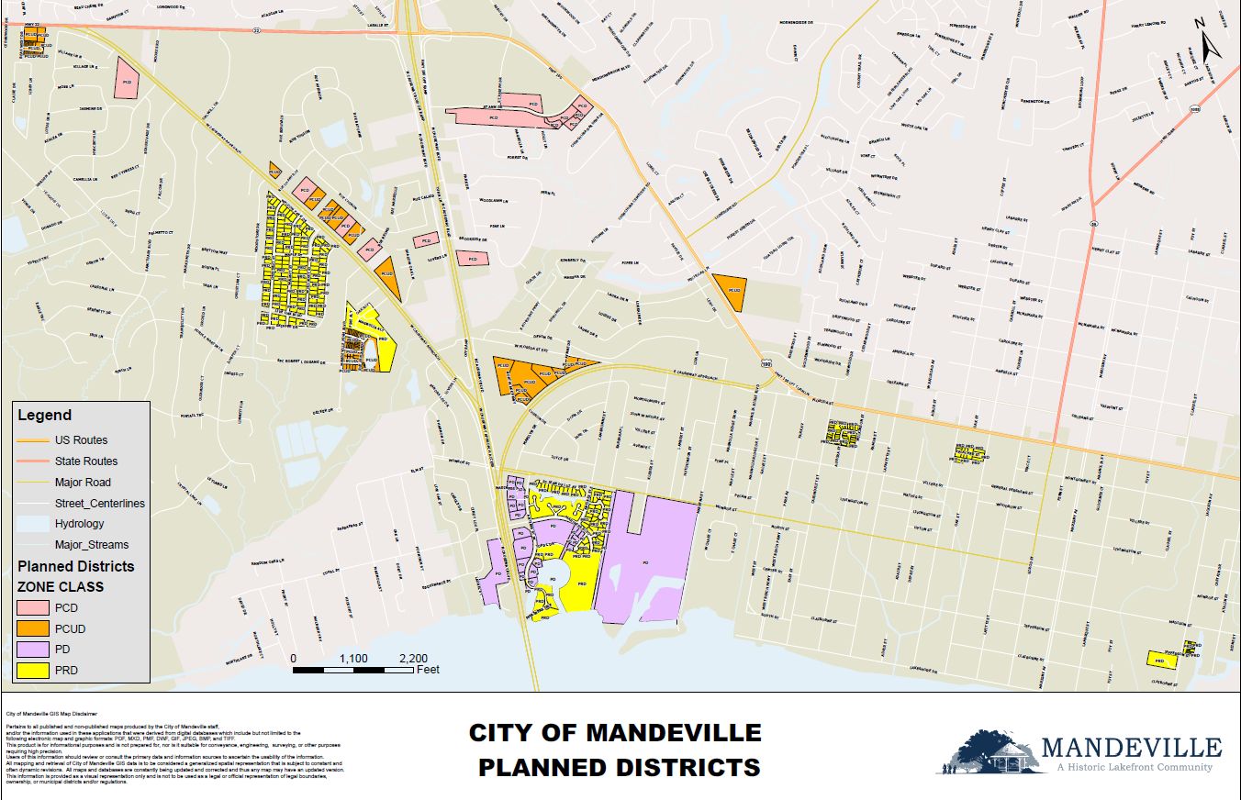

Slide 6
Planned Districts Process
The P&Z Commission first reviews a site plan that depicts the development as a whole and makes a recommendation based upon its review. Then, the City Council creates a unique district that is specific to that parcel of land by Ordinance. The Ordinance outlines the land uses and development regulations solely applicable to the Planned District being created. By their very design, the Planned Districts are to be treated differently than a traditional zoning district, and the proposed development is reviewed holistically instead of the development’s compliance with prescriptive regulations regarding height, impervious coverage, maximum square footage, etc., which are prescribed for specific zoning districts. As such, while the elements of the proposed development are often referenced as a variance from requirements for traditional zoning districts, the specific development criteria must be considered as a whole instead of singular departures from specific applicable regulations in zoning districts.

Slide 7
Process
P&D
Application Submitted to the Planning Dept
P&Z
Commission Held 5 Special Meetings + 1 voting meeting
Commission voted 4-3 to recommend approval with 3 modifications
CC
Commissions decision was forwarded to the City Council
Council Intro. Ordinance 23-18

Slide 8
Timeline of Process
1. Application submitted to the Planning Department on August 18, 2022.
2. Planning & Zoning Commission held 6 Public Hearings:
-September 21, 2022 – General Discussion and Presentation by Applicant
-October 12, 2022– Landscaping, Parking and Site Criteria
-February 13, 2023 – Traffic Study
-March 7, 2023 – Follow up discussion, Recap, Clarify
-March 20, 2023 - Work Session
-April 17, 2023 – Commission made recommendation to the Council
3. Planning & Zoning Commission notified the Council of their Recommendation via Memo on April 27, 2023.
4. City Council voted to hold public hearings on May 11, 2023
5. City Council Introduced an Ordinance on May 11, 2023
6. City Council to hold Public Hearings starting May 25, 2023
7. City Council votes on the application to be determined.

Slide 9
History of the Property

Slide 10
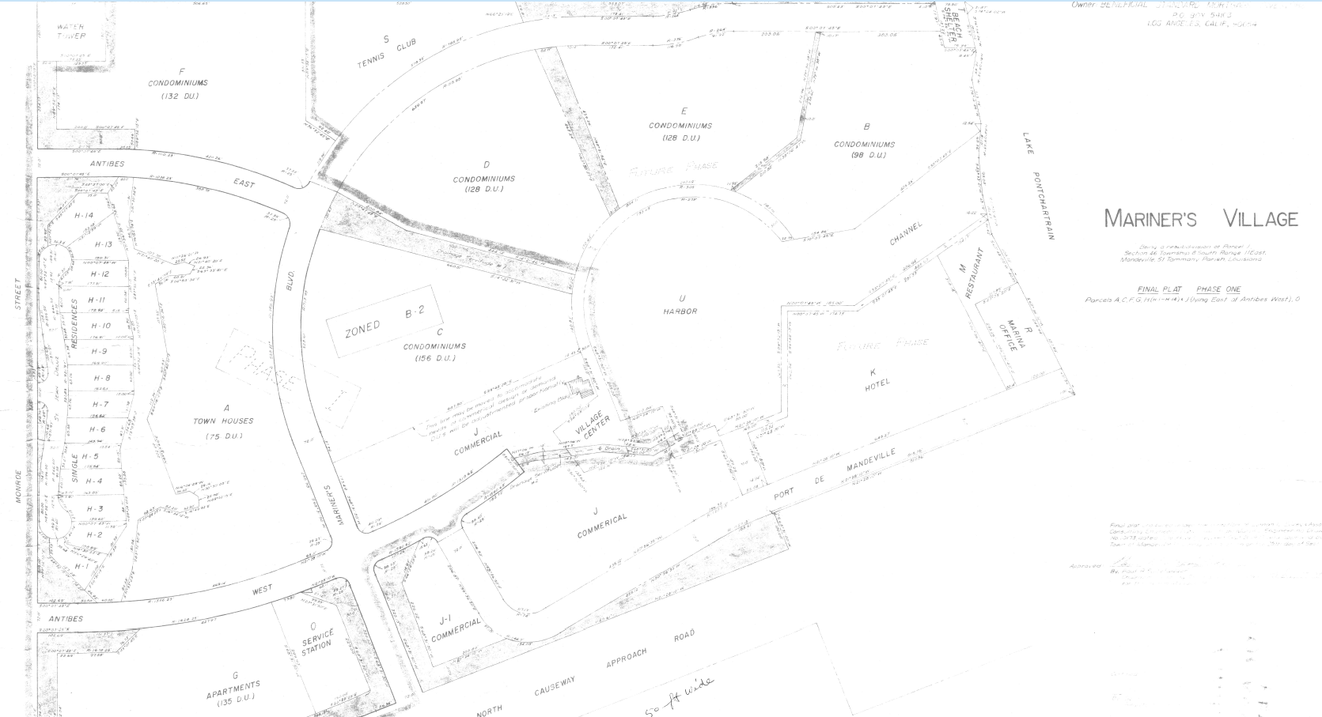

Slide 11
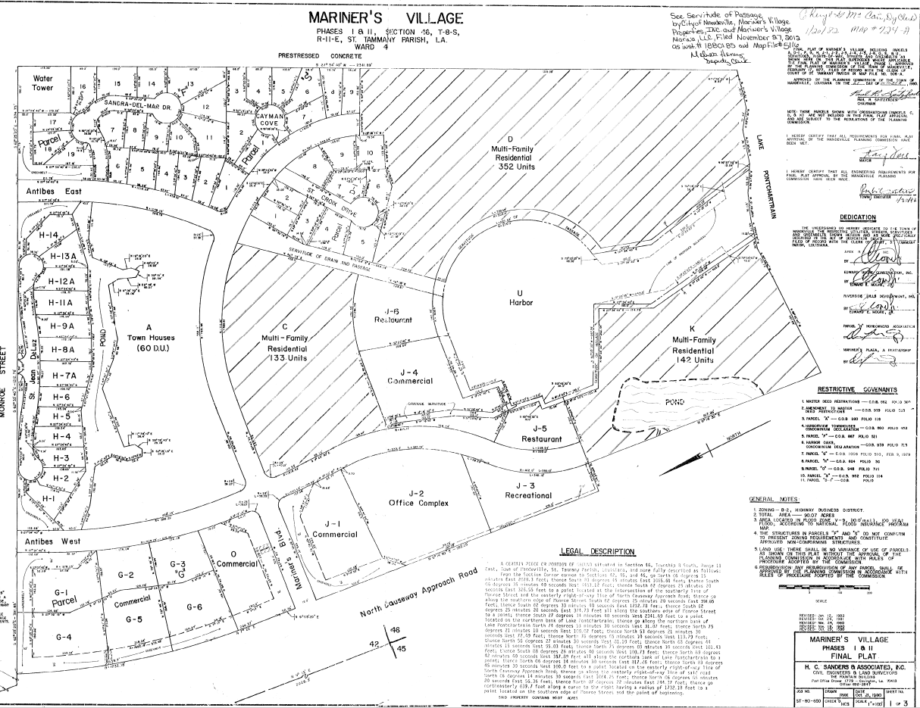
In October 1982, the Mariners Village Phase 1 & 2 subdivision plats were recorded with the St. Tammany Parish Clerk of Court. The Plat indicated that Parcel D was dedicated as multi-family with up to 352 units. The property was zoned Planned District. At this time there were not subcategories of the Planned District.

Slide 12
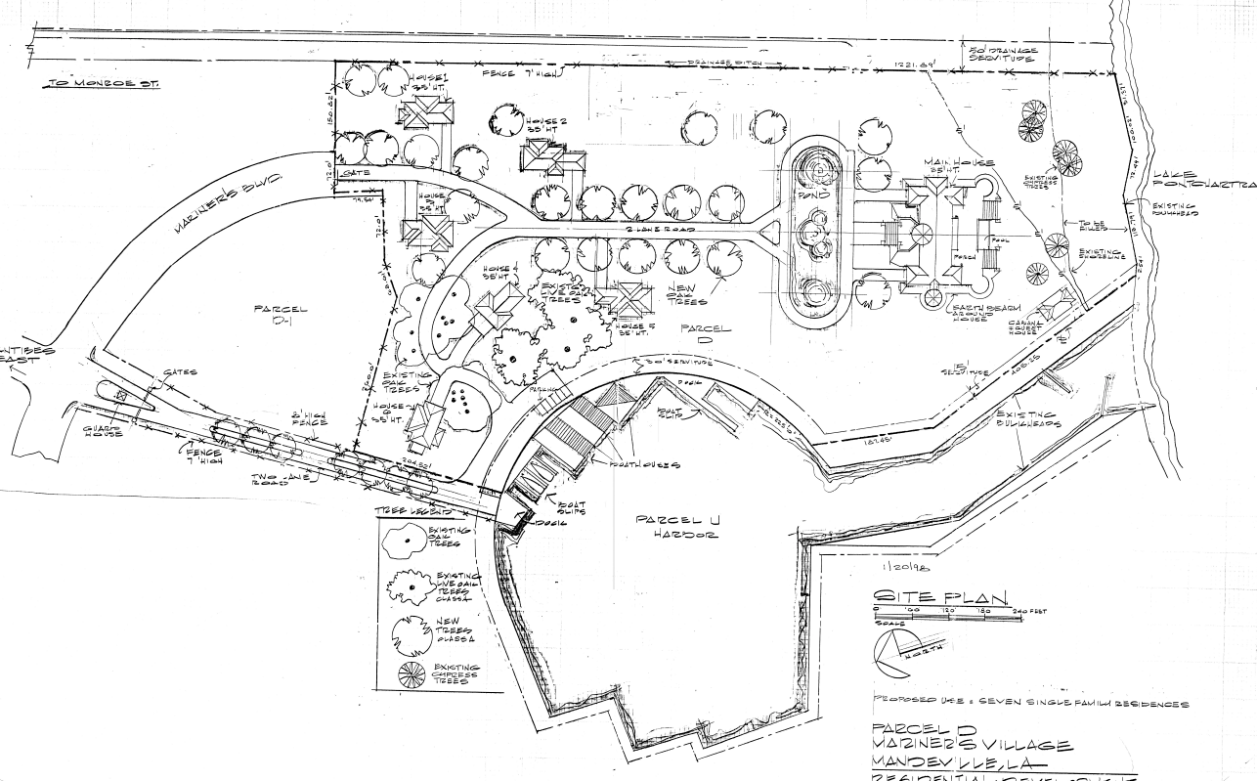
Site Plan for Ordinance 98-40 – Redesignating the Planned District to Planned Residential District

Slide 13
REQUESTS
Z22-10-02 – LSU Health Foundation requests the rezoning of a Planned Residential District to Planned Combined Use District and to establish site development criteria and allowable uses within the district, Parcel D Section 46, Mariners Village Subdivision, PRD Planned Residential District, Mariners Blvd
CU22-10-02 – LSU Health Foundation requests Conditional Use Approval to allow Administrative and Business Offices (6.4.1), Multi-Family Residential (6.2.7), Lodging (Transient) – Hotel/Motel (6.4.44), Restaurant-Sit Down with lounge (6.4.67), General Retail Sales (Conveniences) (6.4.38), Marine Services-Marina (6.4.53) and Marine Services – Retail (6.4.54) as defined in Article 6 - Land Use Classifications per the Table of Permitted Uses, CLURO Section 7.8, Parcel D Section 46, Mariners Village Subdivision, PCUD Planned Combined Use District, Mariners Blvd

Slide 14
LSU Health Foundation owns Parcel D, Mariners Village Subdivision, containing 15 acres, bounded by Lake Pontchartrain to the South, Marineras Village Marina to the west, Mariners Village Subdivision to the North and a City Drainage lateral to the east.

Slide 15
Zoning Request
The property is zoned Planned Residential District per Ordinance 98-40. Section 4.3.3.12 Lapse of Conditional Use Permit or Uses in Conjunction with Planned District Zoning states the uses and site plan approved by Ordinance 98-40 expire after 2 years if a construction permit have not been issued. The zoning remains Planned Residential District. The applicant is proposing multi-family residential uses and commercial uses therefore requiring the property to be rezoned to Planned Combined Use District and establish the permitted uses within the district.

Slide 16
Conditional Uses Requested
Multi-Family Residential – as defined by Section 6.2.7
Administrative and Business Offices, as defined by Section 6.4.1
General Retail Sales (General), as defined by Section 6.4.39
Lodging (Transient) Hotel/Motel, as defined by Section 6.4.44
Marine Services – Boat Sales/Service, as defined by Section 6.4.49
Marine Services – Retail, as defined by Section 6.4.54
Restaurants – Limited Service, as defined by Section 6.4.64.2
Restaurants – Limited Service – Outdoor, as defined by Section 6.4.65
Restaurants – Sit Down with Lounge, as defined by Section 6.4.67

Slide 17
Site Development Criteria
Planned District zoning allows for the departure of the regulations when the developer is able to demonstrate how the submitted plan departs from the regulations and how the departure creates an improved site. The applicant has submitted a statement dated September 21, 2022. The applicant is requesting the following departures from the CLURO:
Height – Section 7.5.4.3 Site Development Criteria – R-3 Multi-Family Residential District
Gross Square Footage of the Hotel – Section 7.5.9.3 Site Development Criteria B-2 Highway Business District
Parking – Section 9.1.4 Minimum Off-Street Parking Requirements
Removal of Live Oaks (Variance) Section 9.2.5.7 Live Oak Protection Requirements

Slide 18
Planning & Zoning Commission
Pursuant to Sect. 4.3.3.7, the Commission has the ability to recommend approval, recommend approval with modifications, or recommend denial, to the City Council.
When considering conditions for approval, the CLURO sets forth that the Commission may recommend and the City Council may establish a myriad of conditions with the goal that those conditions be “necessary to insure compatibility with surrounding uses to preserve the public health, safety, and welfare, and to enable the Commission to make the findings required by the preceding Section.” Sec. 4.3.3.9 provides a non-exhaustive listing.
As stated in the notification to the City Council, the Commission voted to recommend approval subject to the following 3 conditions:
1. A pedestrian and bike path is included on the plans,
2. The landscaping is inspected by the City to ensure health and viability
3. The plans are reviewed by the City’s Design Review Committee
A motion to amend the motion to reduce the square footage and building height to meet the B-2 Site Development Regulations failed (2-5). The original motion was voted on and passed 4-3.

Slide 19
12 Criteria
1. Comparison with applicable regulations and standards established by the Comprehensive Land Use Regulations applicable to the proposed use and site.
2. Compatibility with existing or permitted uses on abutting sites, in terms of building height, bulk and scale, setbacks and open spaces, landscaping and site development, and access and circulation features.
3. Potentially unfavorable effects or impacts on other existing conforming or permitted uses on abutting sites, to the extent such impacts exceed these which reasonably may result from use of the site by a permitted use.
4. Modifications to the site plan which would result in increased compatibility, or would mitigate potentially unfavorable impacts, or would be necessary to conform to applicable regulations and standards and to protect the public health, safety, morals, and general welfare.
5. Safety and convenience of vehicular and pedestrian circulation in the vicinity, including traffic reasonably expected to be generated by the proposed use and other uses reasonable and anticipated in the area considering existing zoning and land uses in the area.
6. Protection of persons and property from erosion, flood or water damage, fire, noise, glare, and similar hazards or impacts
7. Location, lighting, and type of signs; and relation of signs to traffic control and adverse effect on adjacent properties.
8. Adequacy and convenience of off-street parking and loading facilities and protection of adjacent property from glare of site lighting.
9. Conformity with the objectives of these regulations and the purposes of the zone in which the site is located.
10. Compatibility of the proposed use and site development, together with any modifications applicable thereto, with existing or permitted uses in the vicinity.
11. That any conditions applicable to approval are the minimum necessary to minimize potentially unfavorable impacts on nearby uses and to ensure compatibility of the proposed use with existing or permitted uses in the same district and the surrounding area.
12. That the proposed use, together with the conditions applicable thereto, will not be detrimental to the public health, safety, or welfare, or community aesthetics, or materially injurious to properties or improvements in the vicinity

