Slide 2
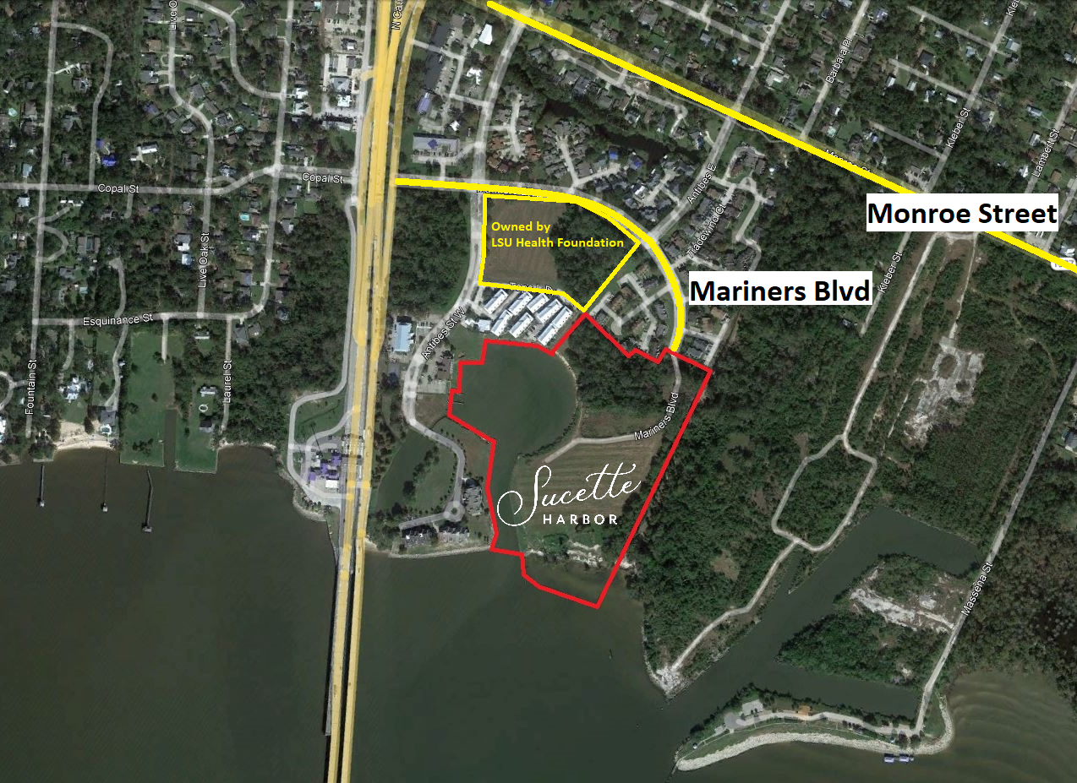
2

Slide 3
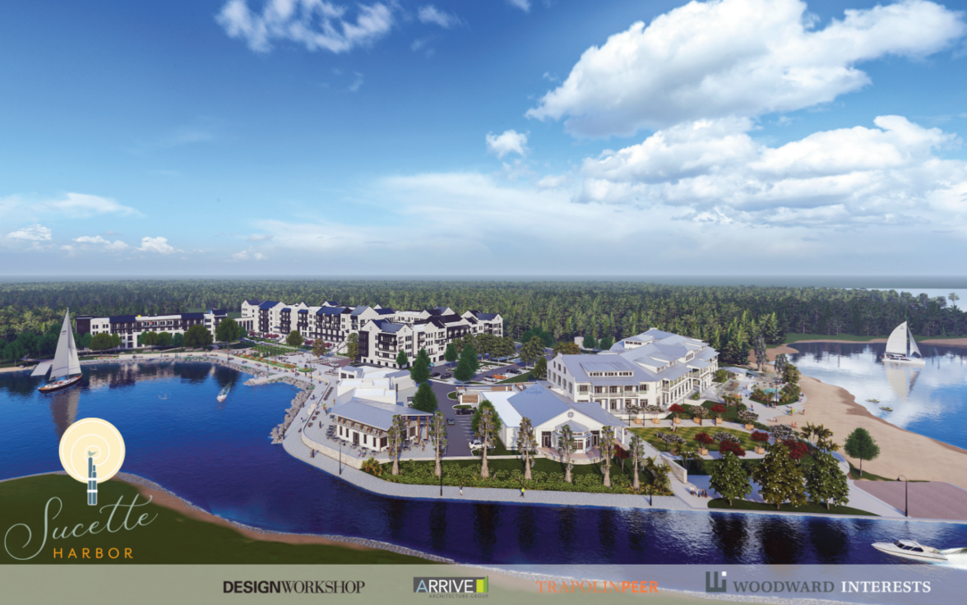
3

Slide 4
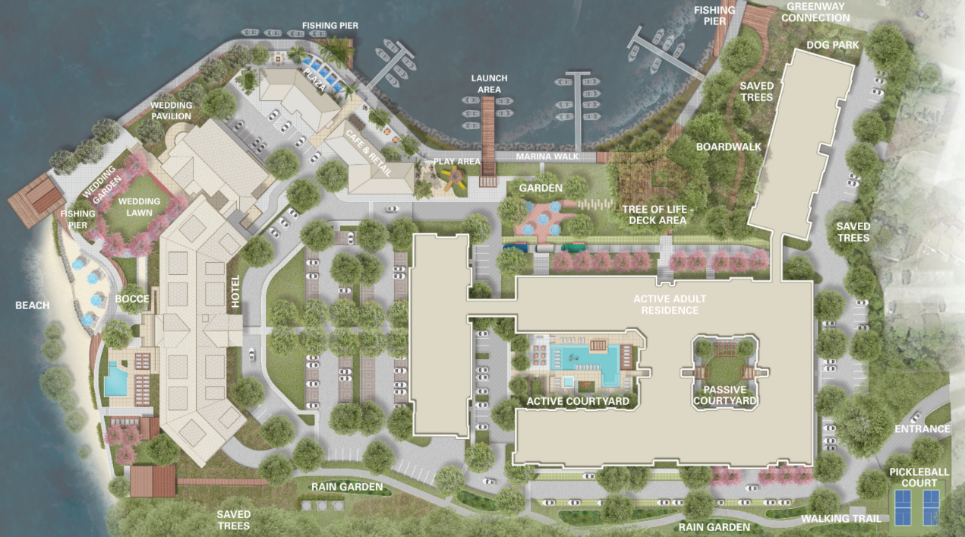
4

Slide 5
Program Overview
Site Size:
Approximately 22.774 acres / 992,035 Square Feet
Program Overview
Active Adult – 201 units
Boutique Hotel – 82 rooms
Food & Beverage –
Two-story restaurant
Café/marina office
Marina – 103 slips
5

Slide 6
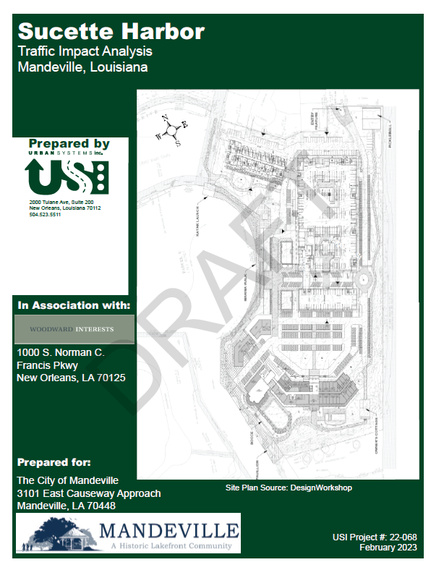
Traffic Impact Analysis
Scope of Study
Coordinated with City on Study Area
Meets Mandeville CLURO requirements
Based on Industry Standards
Urban Systems, Inc.
Locally owned and operated since 1974
Staff on project team has over 35+ years combined Traffic Engineering experience
Professional Engineers and Professional Traffic Operations Engineers
Team member lived in Lewisburg neighborhood near Mandeville
6

Slide 7
Data Collection
Counts in October 2022
Field Observations
Historic Traffic Counts
Regional Planning Commission Model
ITE Trip Generation
Crash history
7

Slide 8
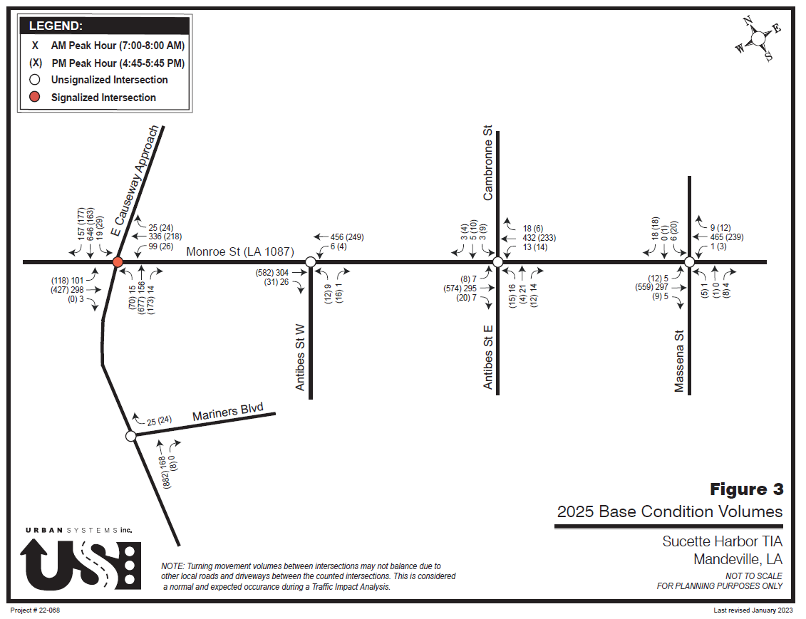
Data Collection
8

Slide 9
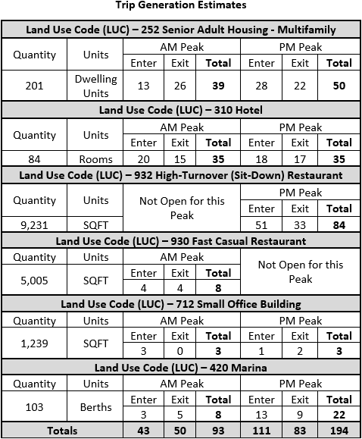
Trip Generation Estimates
Industry Standard based on Institute of Transportation Engineers 11th Edition Trip Generation Manual
Proposed Operations
Conservative Approach
9

Slide 10
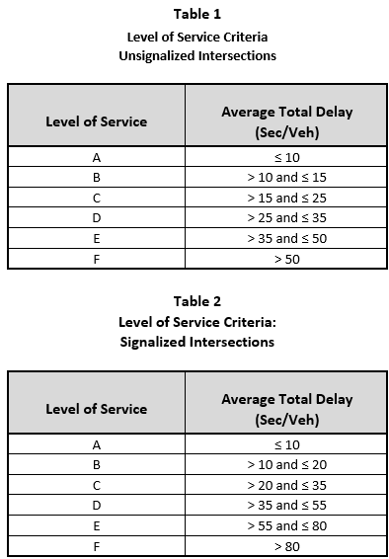
Capacity Analysis – CLURO Requirements
Level of Service
Street Classification
Local LOS C
Arterial/Collector LOS D
Volume to Capacity Ratio (v/c) < 1.0
2025 Base and 2045 Design Year
10

Slide 11
Impact
E Causeway Approach at Monroe St
2025 Overall Average Intersection Delay Scenarios
Peak | 2025 Base | 2025 Build vs Base
AM | 28.2 sec/veh | +1.2 sec/veh
PM | 25.3 sec/veh | + 1.8 sec/veh
2045 Overall Average Intersection Delay Scenarios
Peak | 2045 Build vs No Build | 2045 Build with Westbound Left Turn Lane vs No Build
AM | +3 sec/veh | -6.5 sec/veh
PM | +3.1 sec/veh | -0.8 sec/veh
11

Slide 12
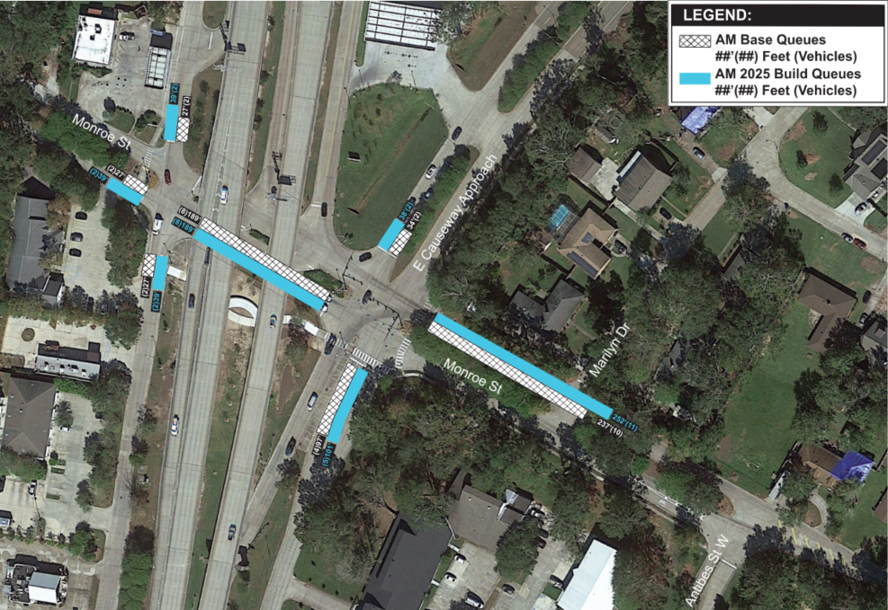
AM Queue Map
Data Collection
12

Slide 13
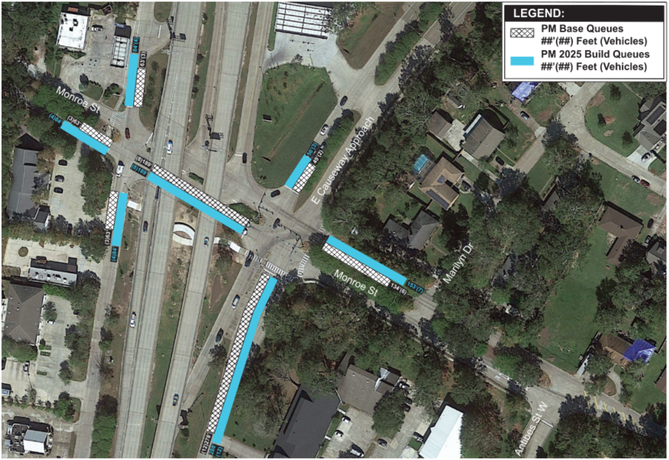
PM Queue Map
Data Collection
13

