Slide 1
1

Slide 2
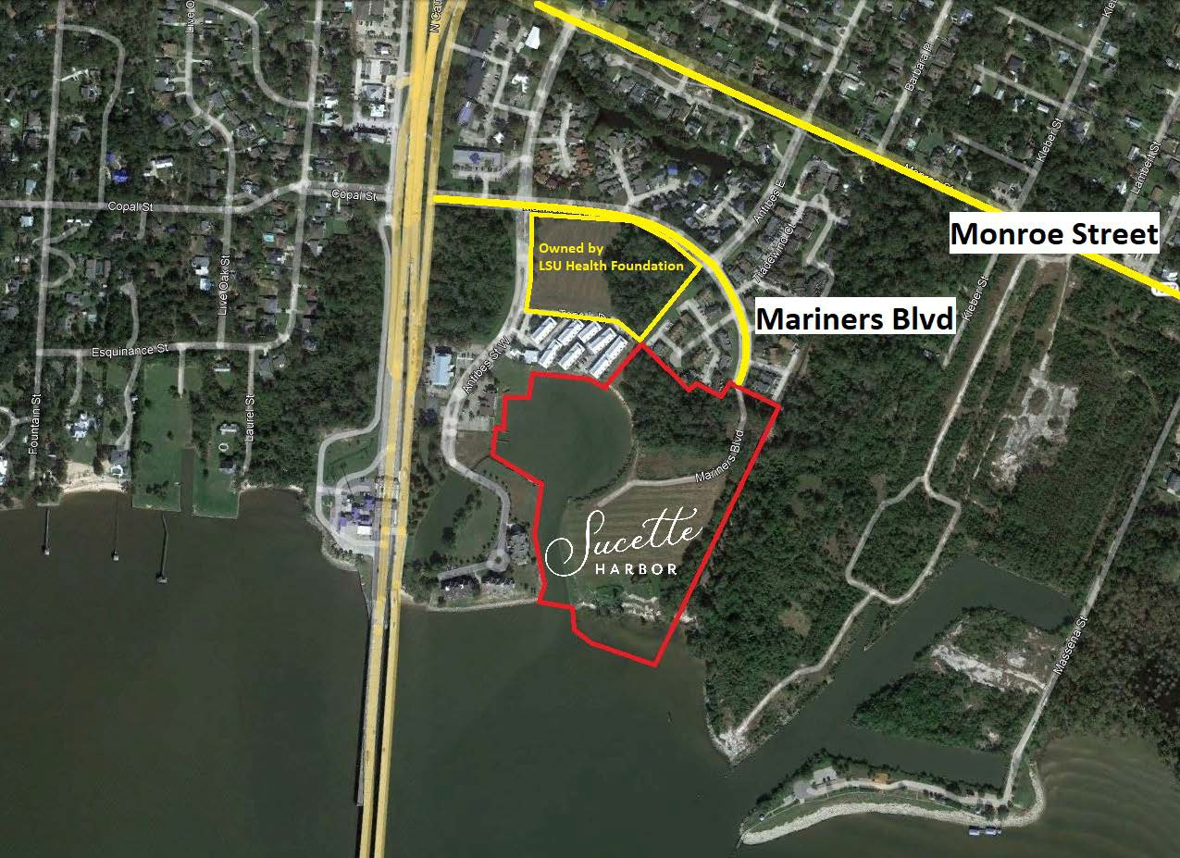

Slide 3
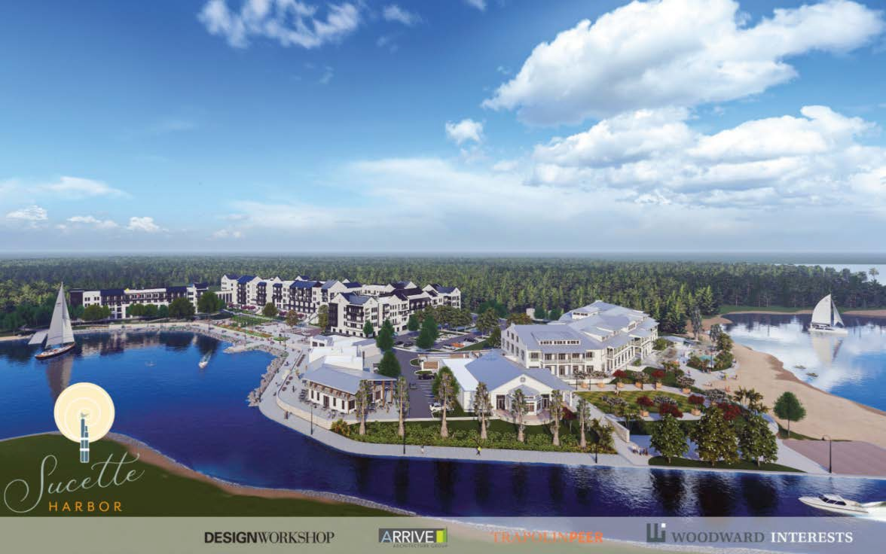
3

Slide 4
Impact
E Causeway Approach at Monroe St
2025 Overall Average Intersection Delay Scenarios
Peak | 2025 Base | 2025 Build vs Base
AM | 28.2 sec/veh | +1.2 sec/veh
PM | 25.3 sec/veh | + 1.8 sec/veh
2045 Overall Average Intersection Delay Scenarios
Peak | 2045 Build vs No Build | 2045 Build with Westbound Left Turn Lane vs No Build
AM | +3 sec/veh | -6.5 sec/veh
PM | +3.1 sec/veh | -0.8 sec/veh
11

Slide 5
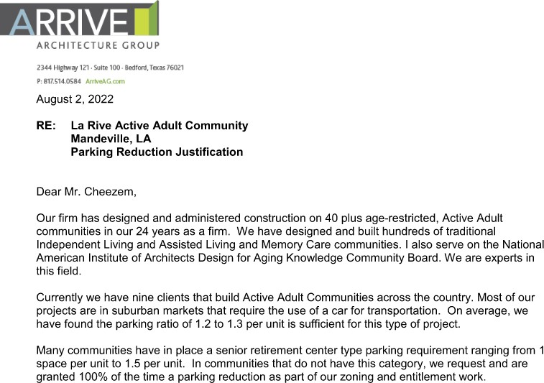

Slide 6
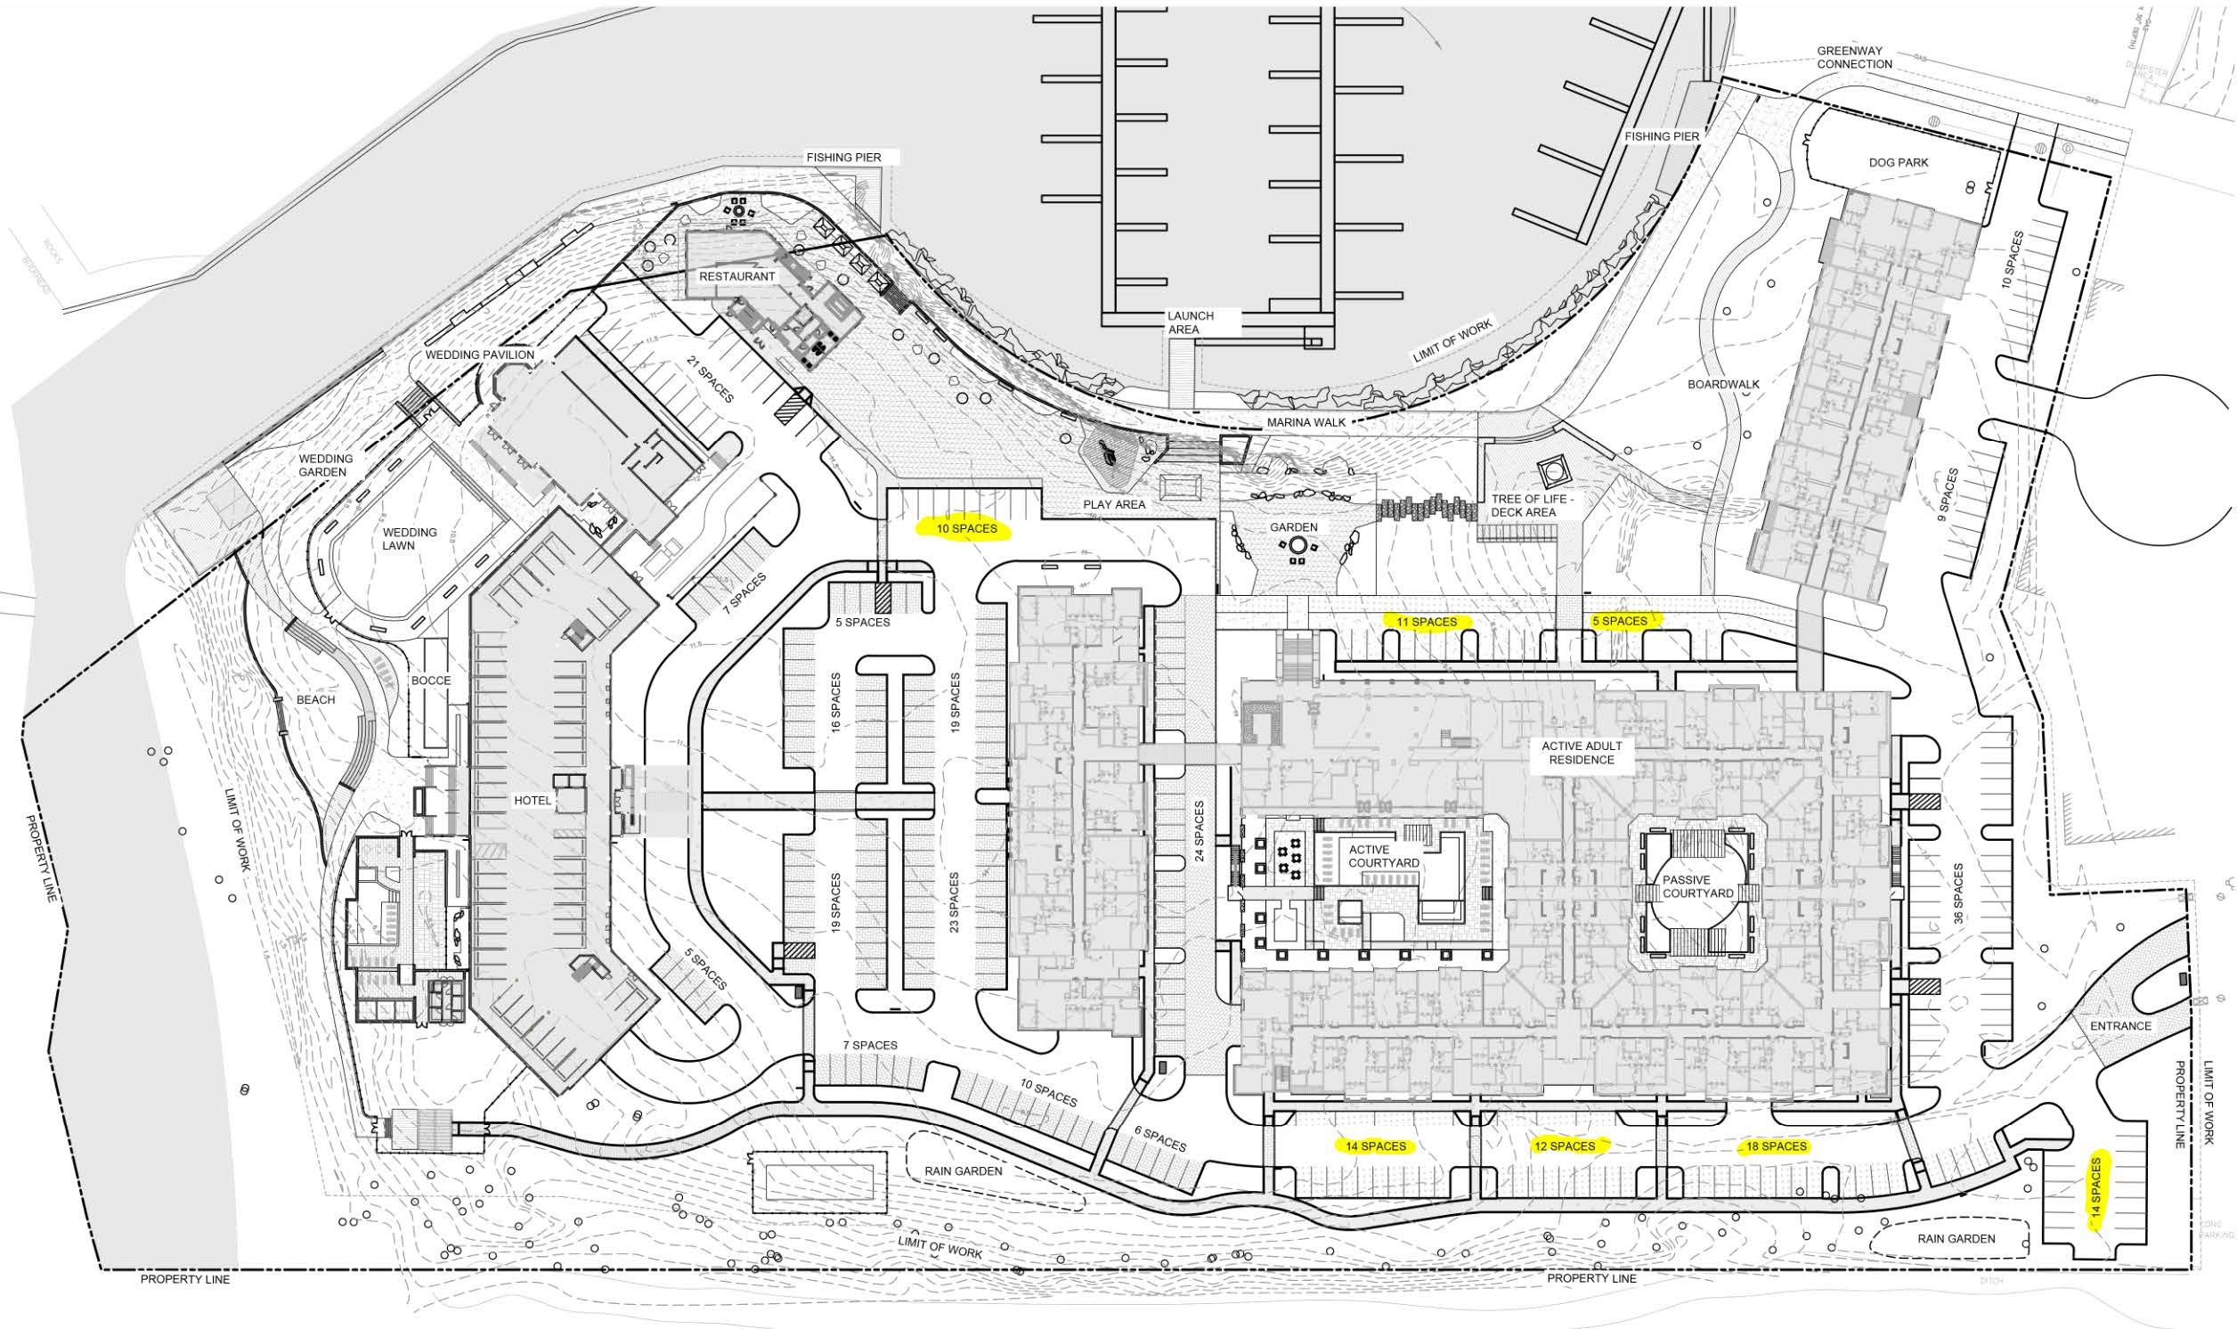

Slide 7
 | Per Code |  | Sucette Harbor
 | Congregate | Multi-Family | Active Adult
Residential - surface |  |  | 77
Residential - Covered |  |  | 237
Residential - Per Design |  |  | 314
Residential - Parking Bank |  |  | 74
Residential - Total | 302 | 402 | 388
Hotel - Covered |  |  | 54
Hotel - Surface |  |  | 75
Hotel - Total | 129 | 129 | 129
Restaurant | 45 | 45 | 45
Marina | 26 | 26 | 30
Slips rented by Residents |  |  | (8)
Marina Retail | 5 | 5 | 5
Marina - Total | 31 | 31 | 27
 | 507 | 607 | 589
Maximum based on Operations (Friday / Saturday) |  |  | 451

Slide 8
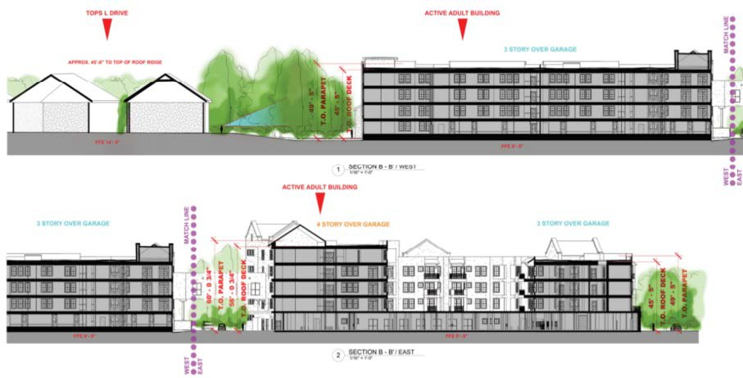

Slide 9
9

Slide 10
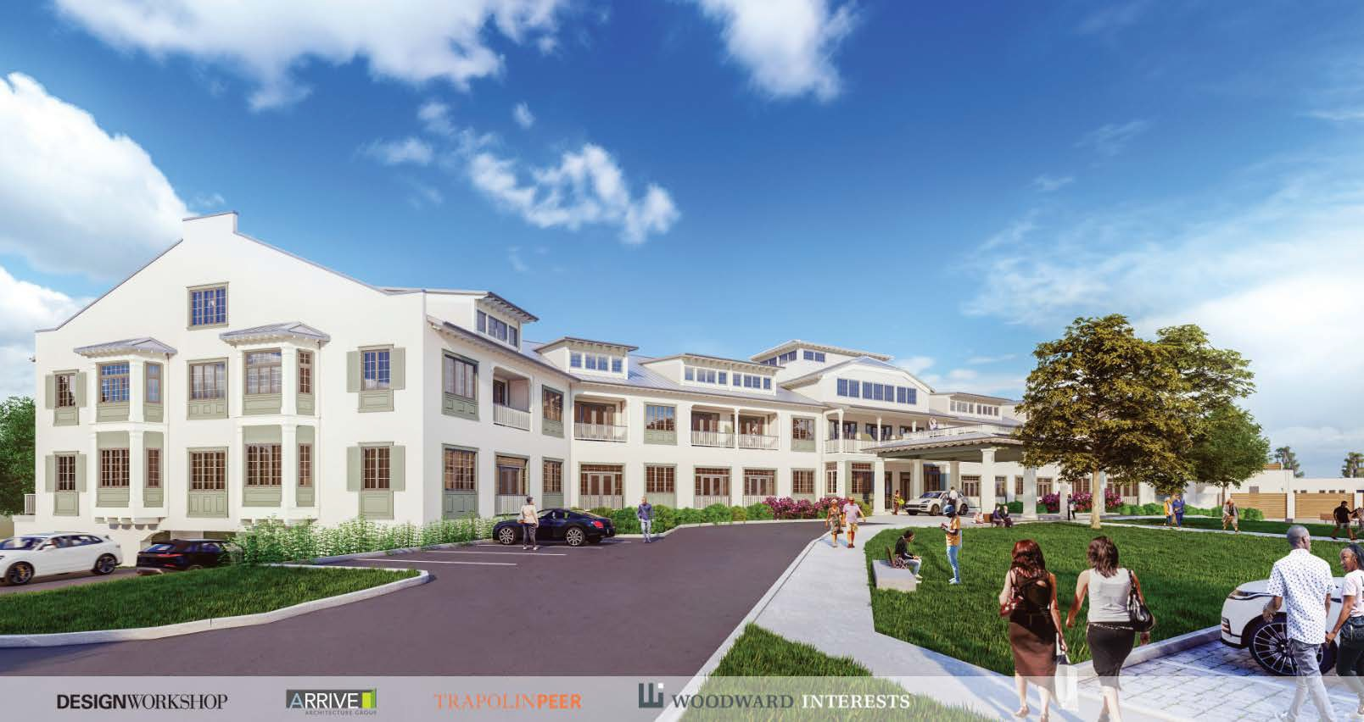
10

Slide 11
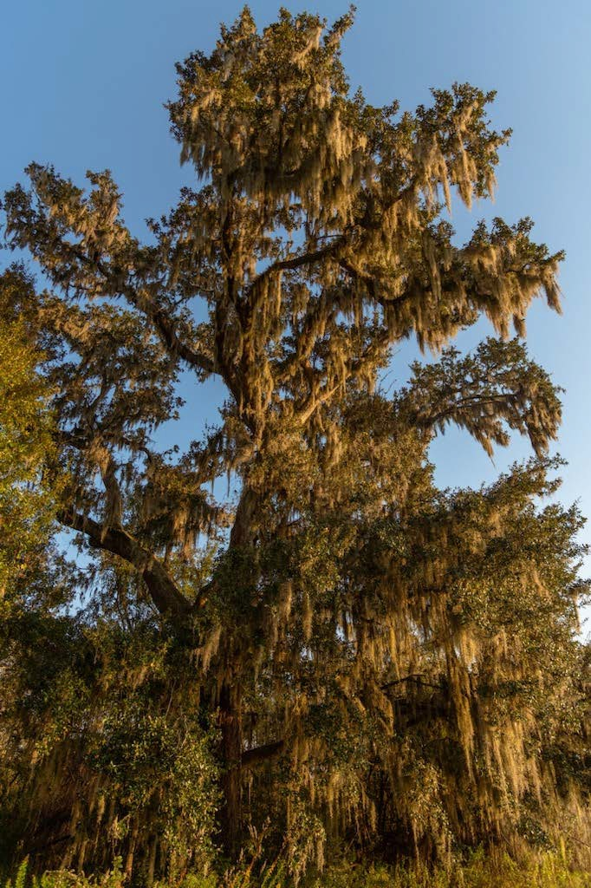
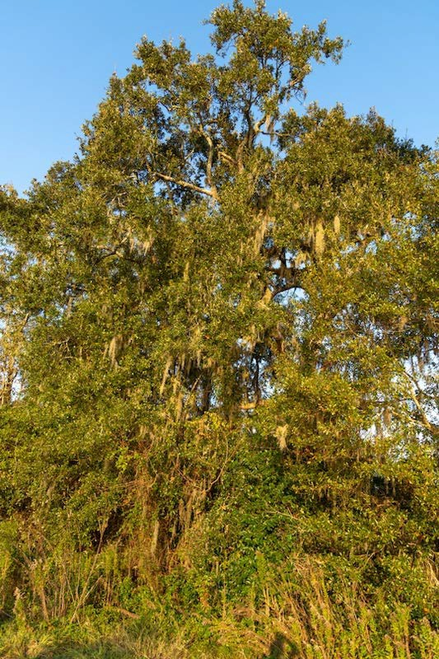
Trees to be preserved
11

Slide 12
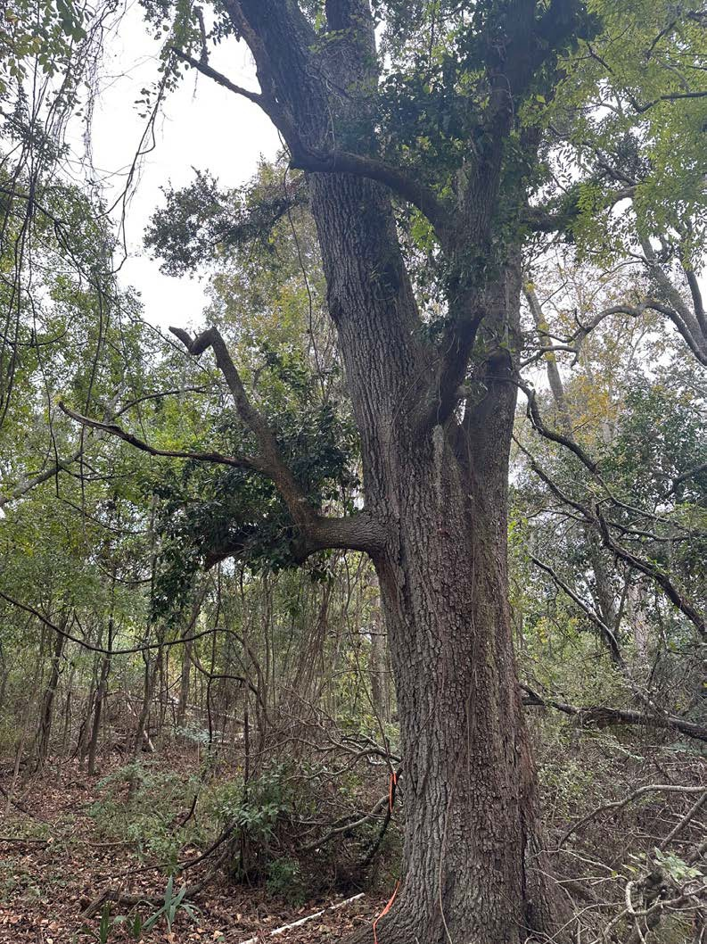
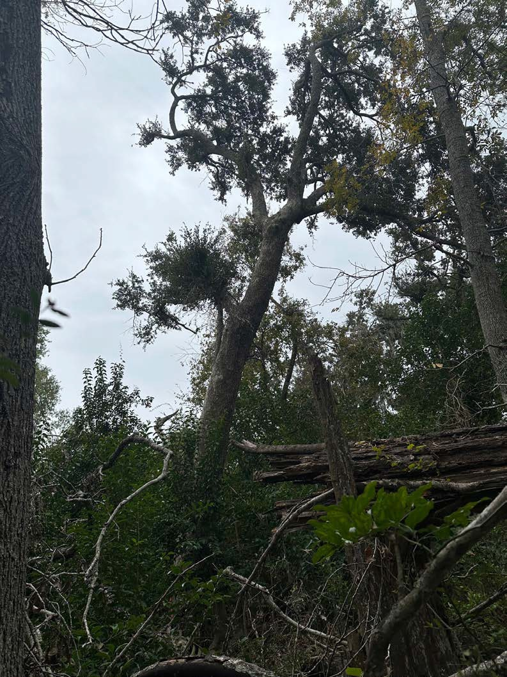
Trees to be removed
12

Slide 13
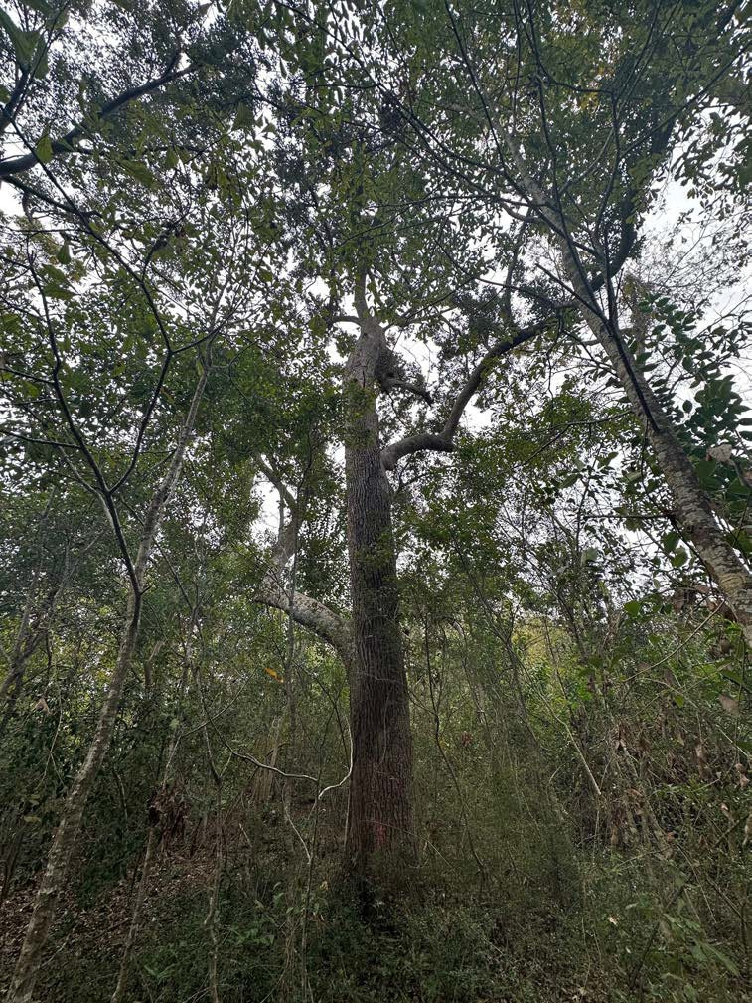
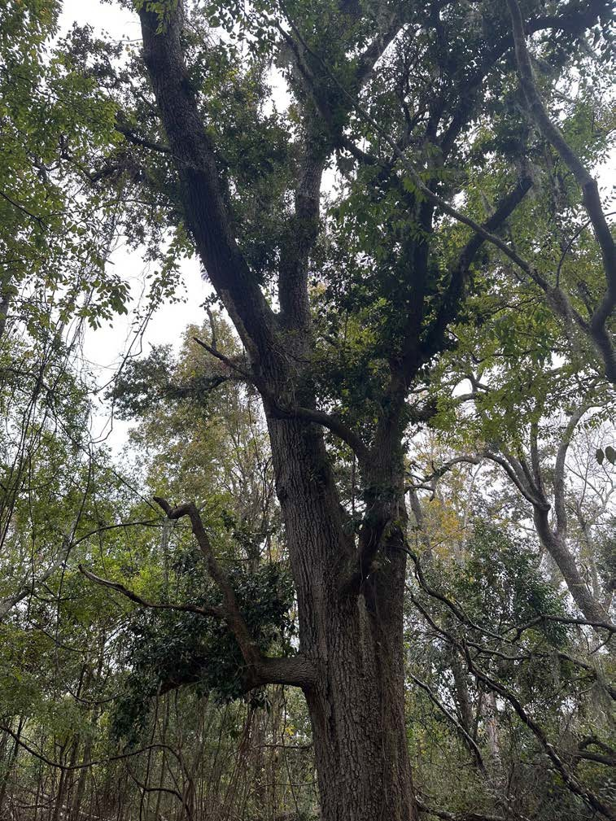
Trees to be removed
13

Slide 14
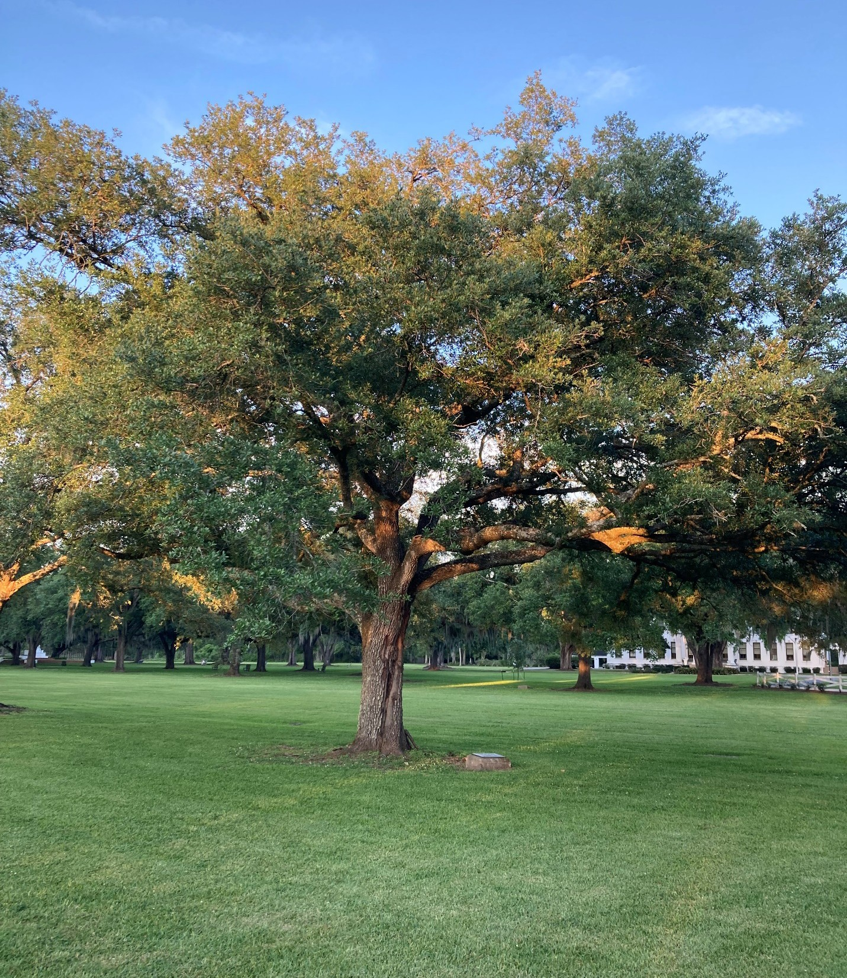
30 Year HEALTY Live Oak

Slide 15
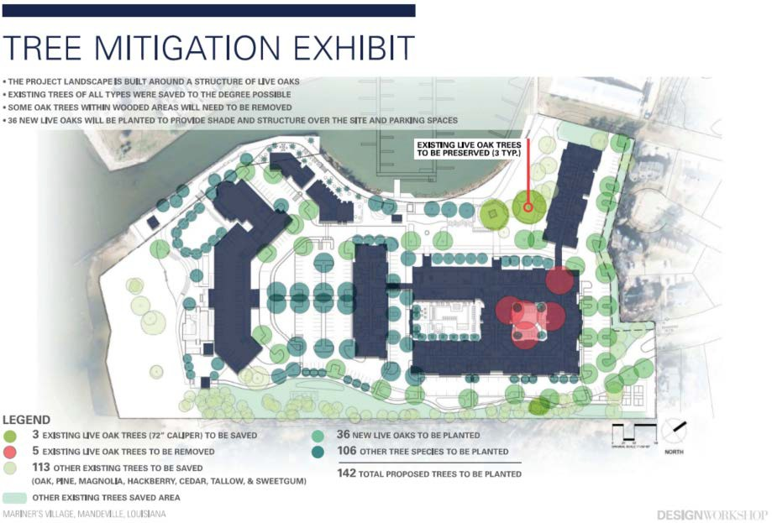

Slide 16
Sucette Harbor – Estimated Economic Impact
Estimated Annual Property Tax:
Combined between all outlets: $500,000
Millage
Ongoing Operations Sales Tax:
Sales tax rate: 9.2% on estimated $8 million in revenue
City 0.50% $ 40,000
Total Estimated 9.20% $ 736,000
One-Time Construction Materials Sales Tax:
Sales tax rate: 9.2% on estimated $75 million in material cost
Percentage
Tax Proceeds
School District | 62.00 | 47.4% | $ 237,000
Fire District 4 | 25.38 | 19.4% | $ 97,000
St. Tammany Law Enforcement | 11.14 | 8.5% | $ 42,000
City of Mandeville | 8.86 | 6.8% | $ 34,000
Recreation District 1 | 6.75 | 5.2% | $ 26,000
Library | 5.78 | 4.4% | $ 22,000
State | 4.45% | $ 356,000
Parish | 4.25% | $ 340,000
Other public services 11.01 8.4% $ 42,000 Total Estimated 130.92 100.0% $ 500,000
Total Employment:
▻ Approximately 80 new full-time employee equivalents
State Parish
4.45%
4.25%
$ 3,338,000
$ 3,188,000
City 0.50% $ 375,000
Total Estimated 9.20% $ 6,900,000

Slide 17
17

