Slide 2
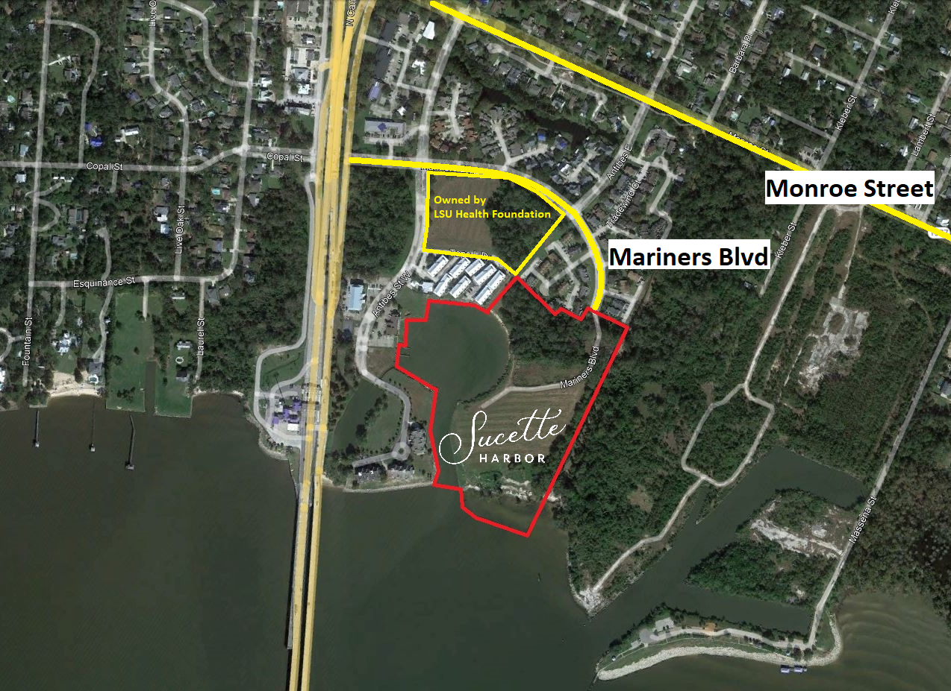
2

Slide 3
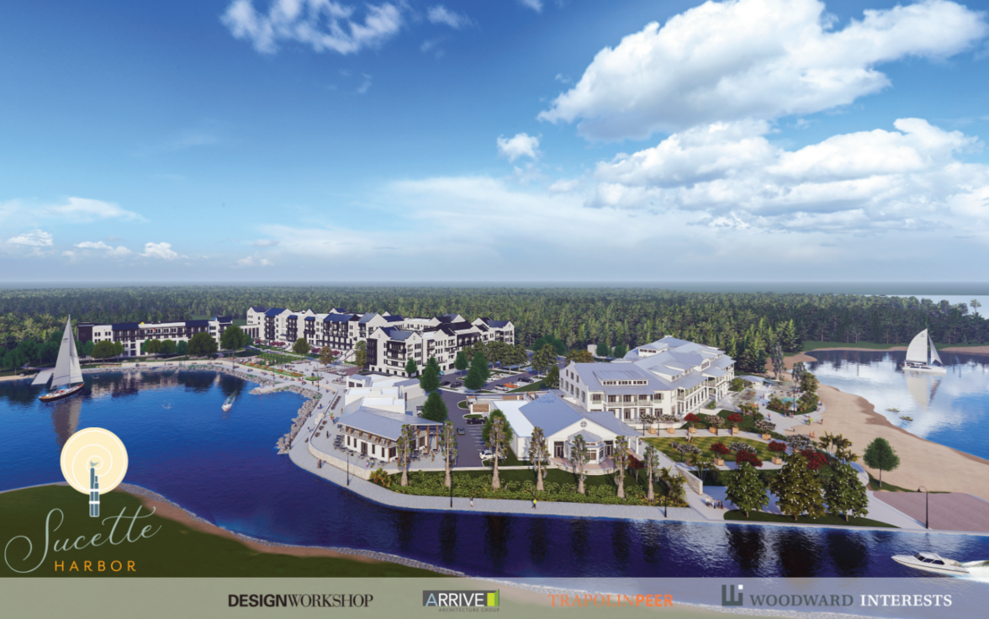
3

Slide 4
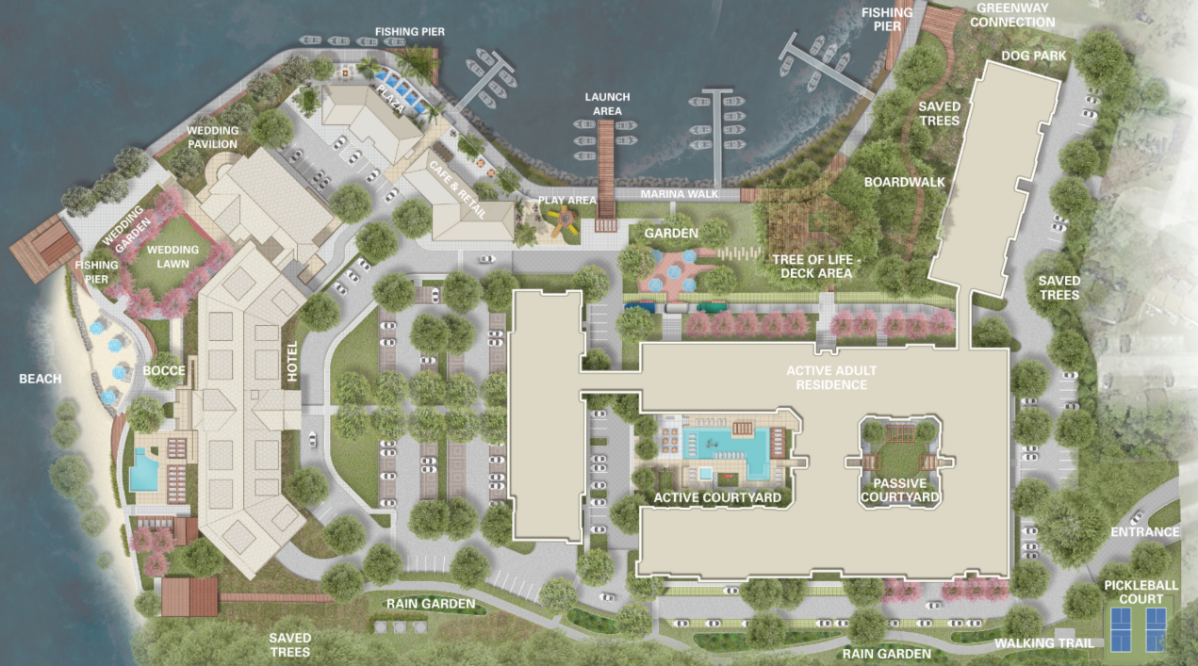
4

Slide 5
Program Overview
Site Size:
Approximately 22.774 acres / 992,035 Square Feet
Program Overview
Active Adult – 201 units
Boutique Hotel – 82 rooms
Food & Beverage –
Two-story restaurant
Café/marina office
Marina – 103 slips
5

Slide 6
Trip Generation Side by Side
The multifamily land use code would add 38 cars in the AM and 29 cars in the PM.

Slide 7
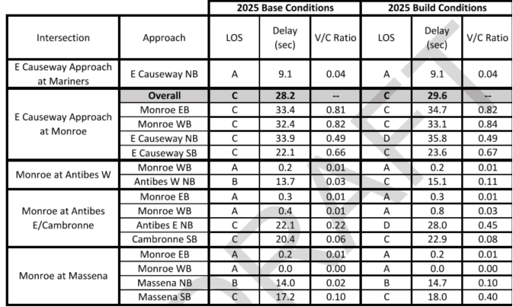
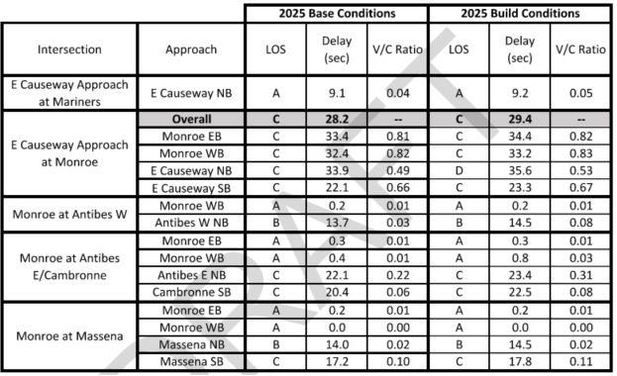
Traffic Impact Side by Side
Multifamily
Senior Adult
The multifamily land use code would add .2 Seconds to the average delay at Causeway and Monroe.

