Slide 1





Slide 2
Agenda – September 21, 2022
Background
Site Characteristics
Sucette Harbor Development
Departures from CLURO
Benefits to the Community

Slide 3
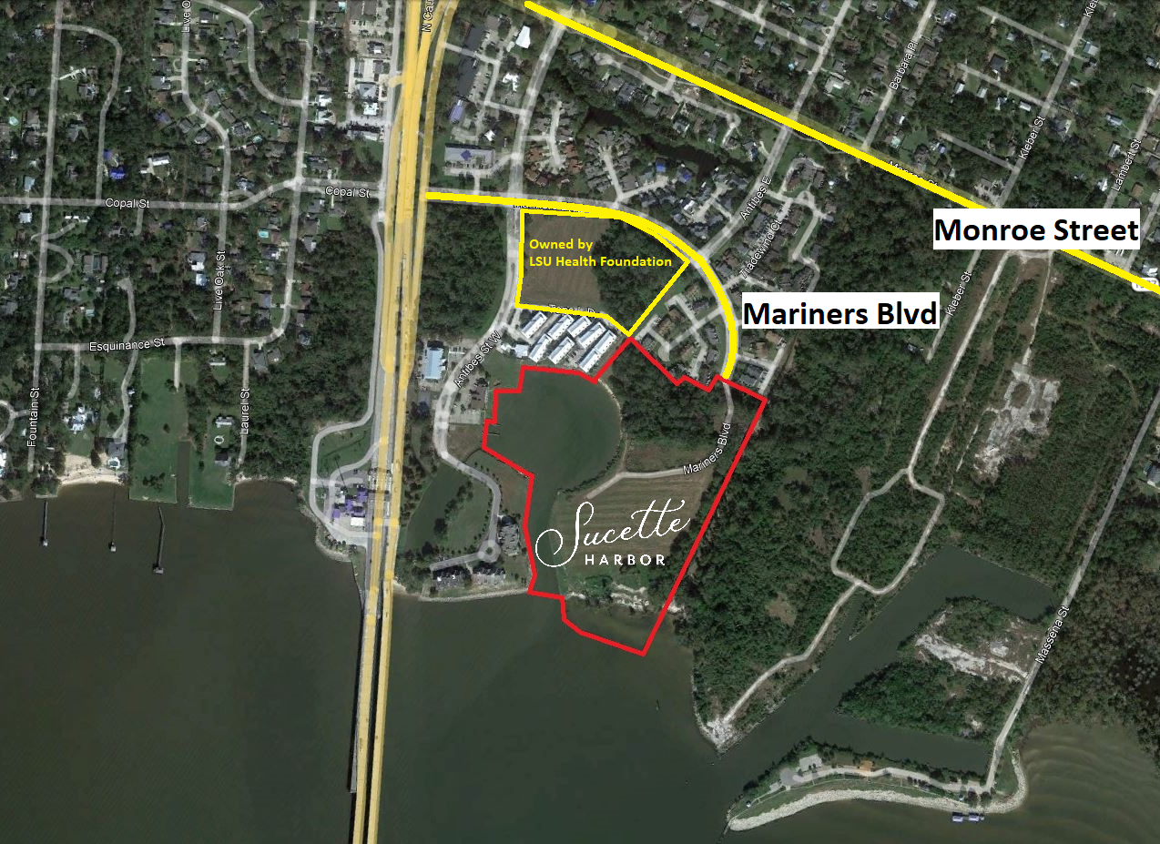

Slide 4
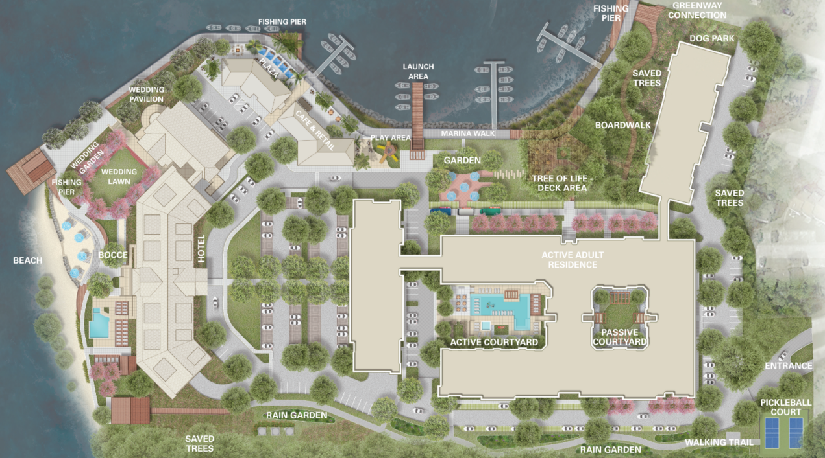

Slide 5
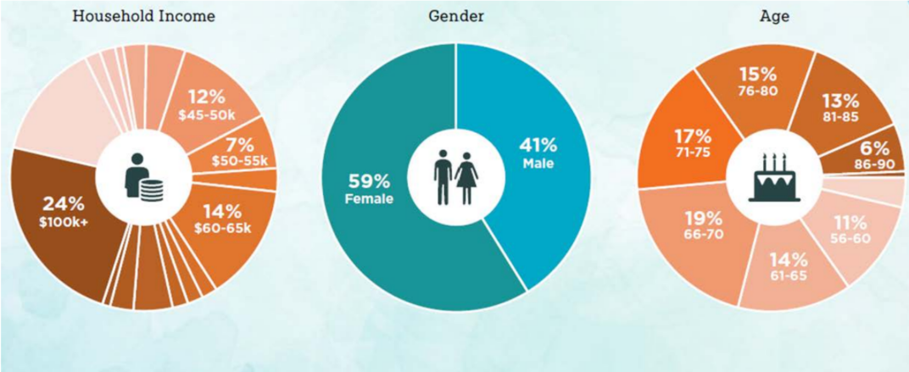
Active Adult Community
  Active Adult Communities:
  Average age is between 72-74
  41% are married
  Residents seek to live amongst their peers
  The property is focused on programmed common spaces for socialization and wellness
  Average turnover is less than typical multifamily properties

Slide 7
Program Overview
Site Size:
          Approximately 22.774 acres / 992,035 Square Feet
Program Overview
Active Adult – 201 units
Boutique Hotel – 82 rooms
Food & Beverage –
  Two-story restaurant
  Café/marina office
Marina – 103 slips

Slide 8
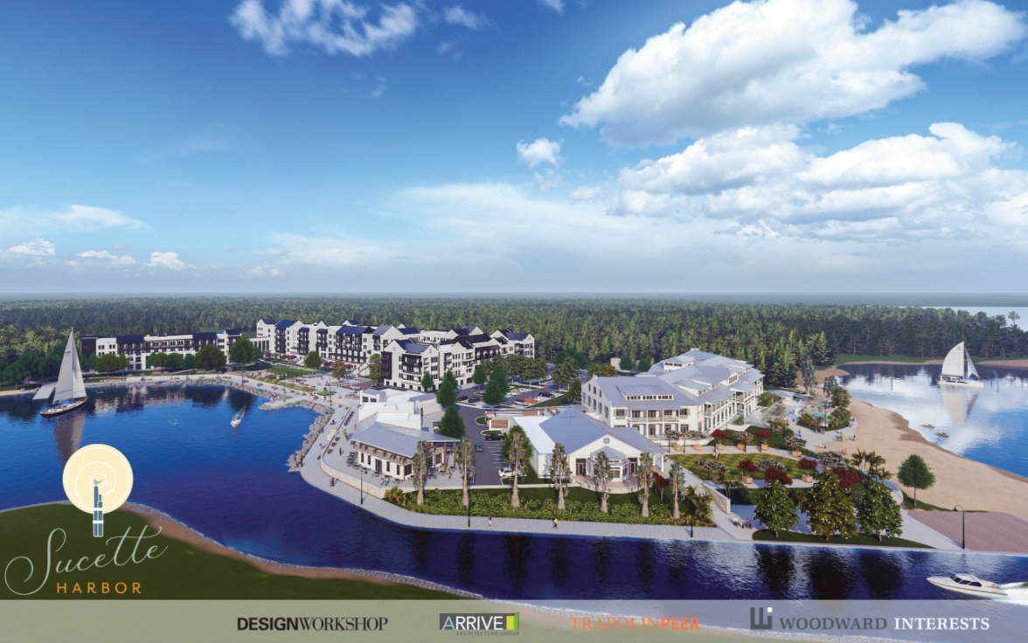

Slide 9
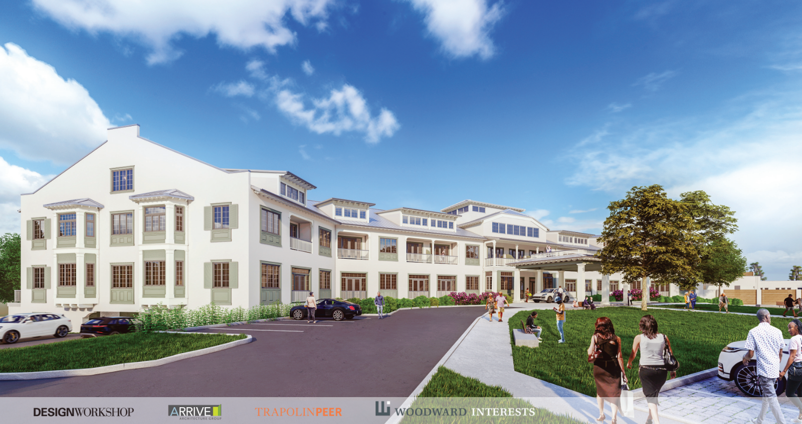

Slide 10
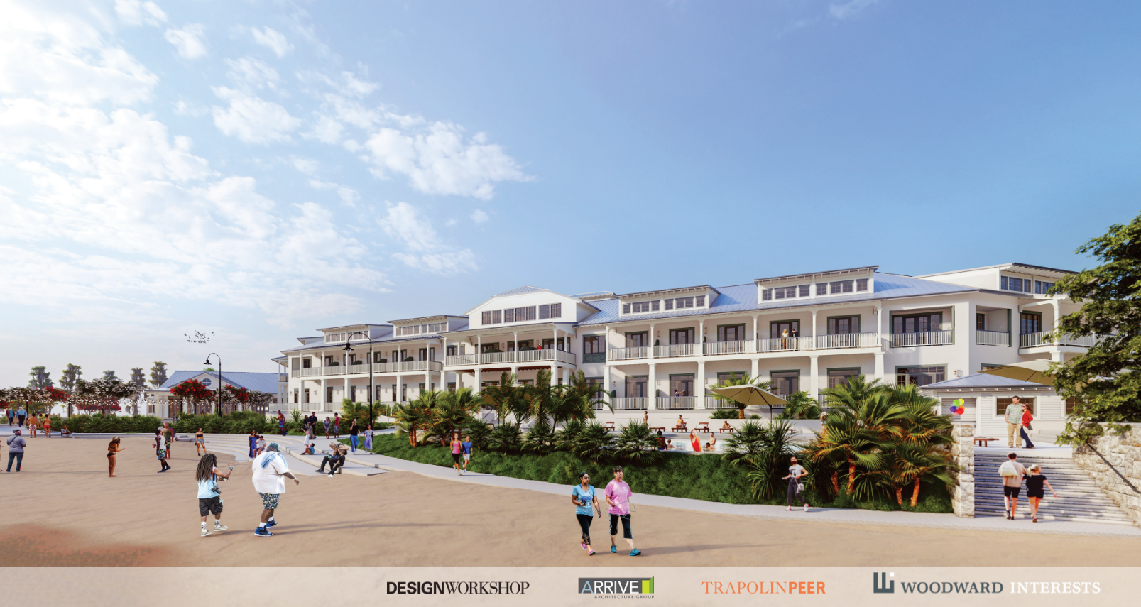

Slide 12
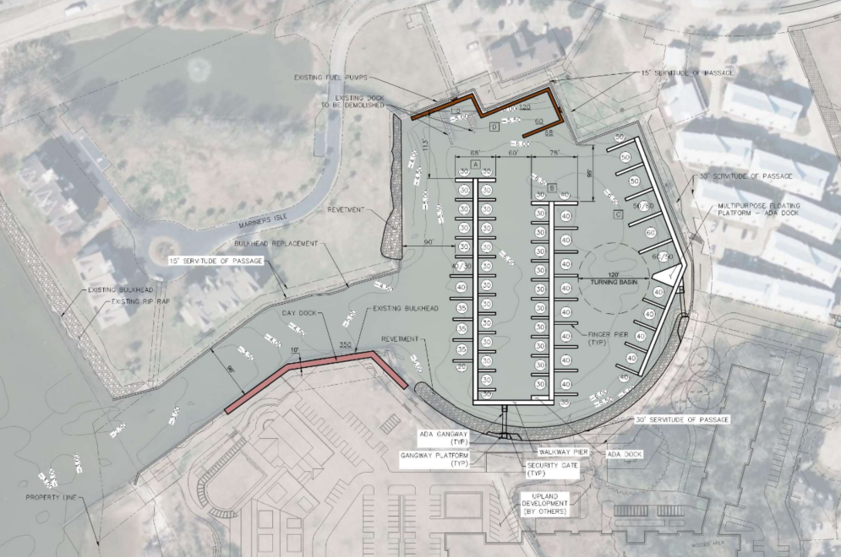

Slide 13
Departures from CLURO
  Height
  Parking
  Live Oak Trees
  Hotel Building Size
  Benefits to the City for the Departures

Slide 14
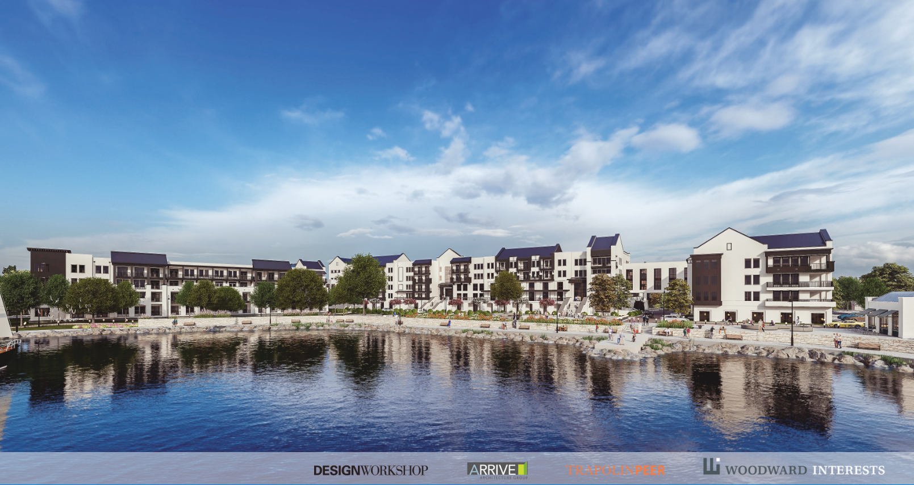

Slide 15
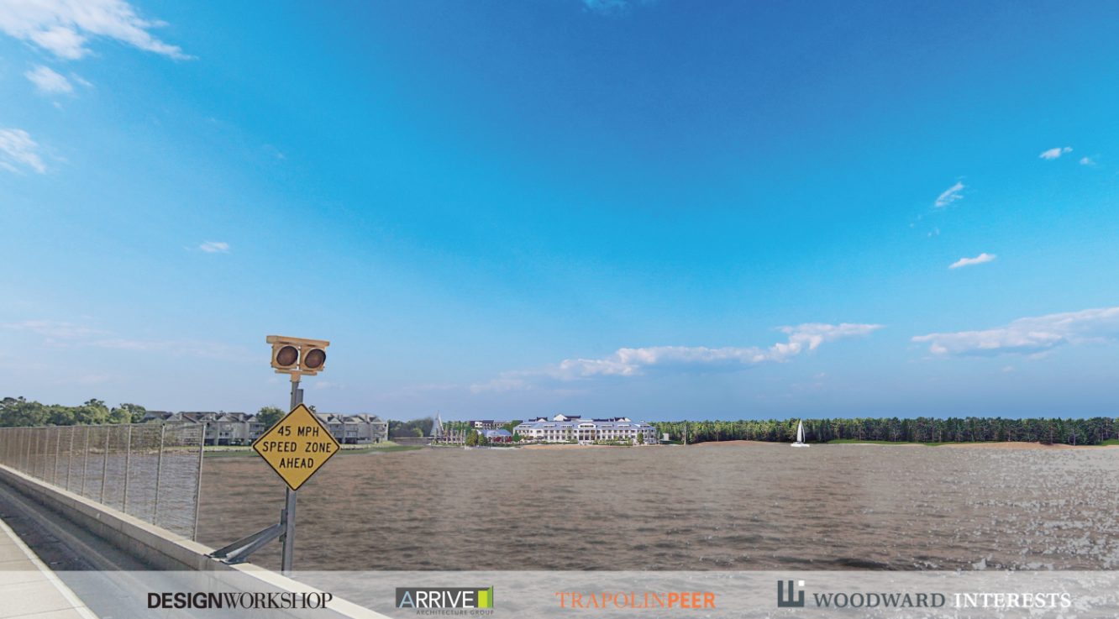

Slide 16
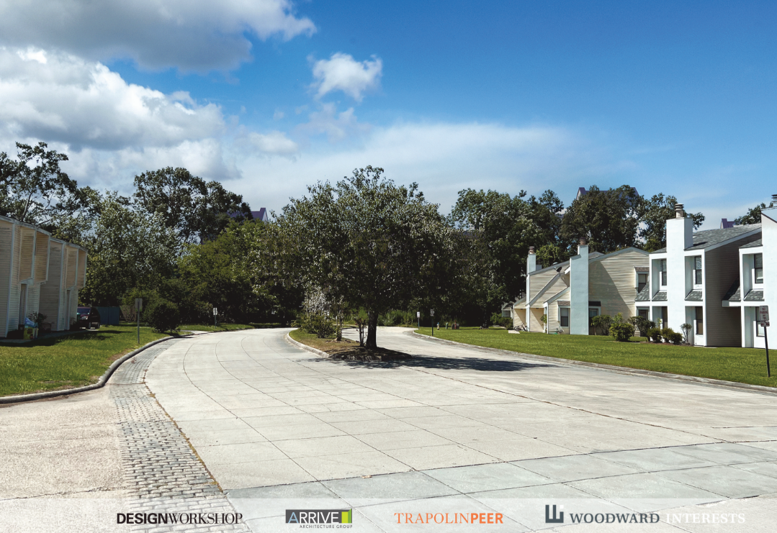

Slide 17
Departures from CLURO
  Height
  Parking
  Live Oak Trees
  Hotel Building Size
  Benefits to the City for the Departures

Slide 18
Parking

Slide 19
Departures from CLURO
  Height
  Parking
  Live Oak Trees
  Hotel Building Size
  Benefits to the City for the Departures

Slide 20
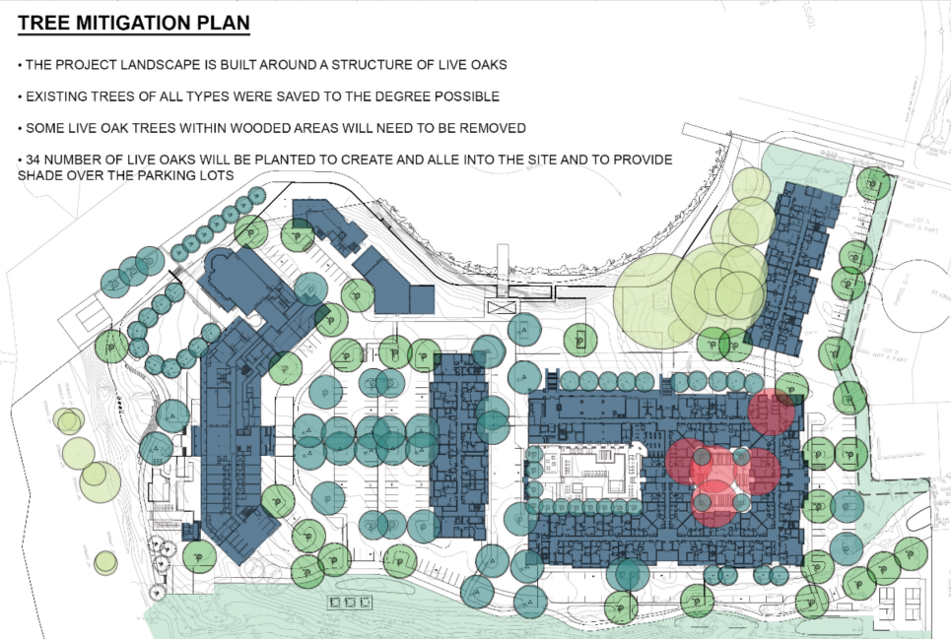
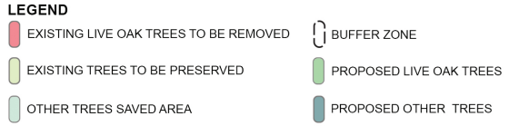

Slide 21
Departures from CLURO
  Height
  Parking
  Live Oak Trees
  Hotel Building Size
  Benefits to the City for the Departures

Slide 23
Departures from CLURO
  Height
  Parking
  Live Oak Trees
  Hotel Building Size
  Benefits to the City for the Departures

Slide 24
Benefits to the Community
  Cancer research funding – LSU Health Foundation
  Luxury retirement community
  Hotel for visitors
  Open space with walking trails
  Additional access to the Lakefront

Slide 25
Estimated Economic Impact to the City of Mandeville
  Total Employment: Approximately 80 new full-time employees
  One-Time Construction Materials Sales Tax: $375,000 sales tax paid to the City of Mandeville
  Estimated Annual Property Tax: $27,000-$34,000 paid to the City of Mandeville
  Estimated Ongoing Operations Sales Tax: $40,000

