Slide 1





Slide 2
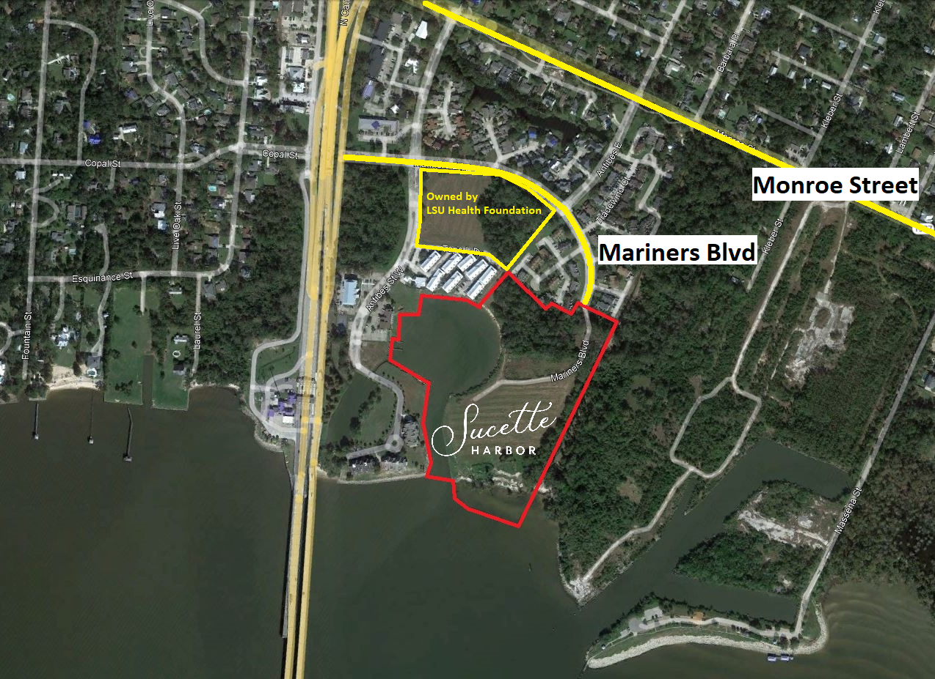

Slide 3
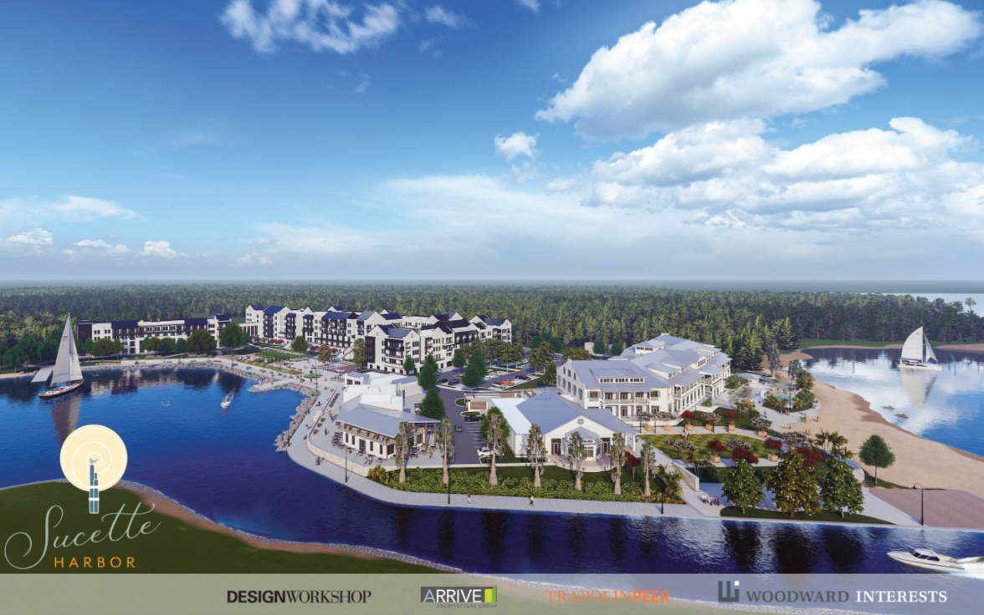

Slide 4
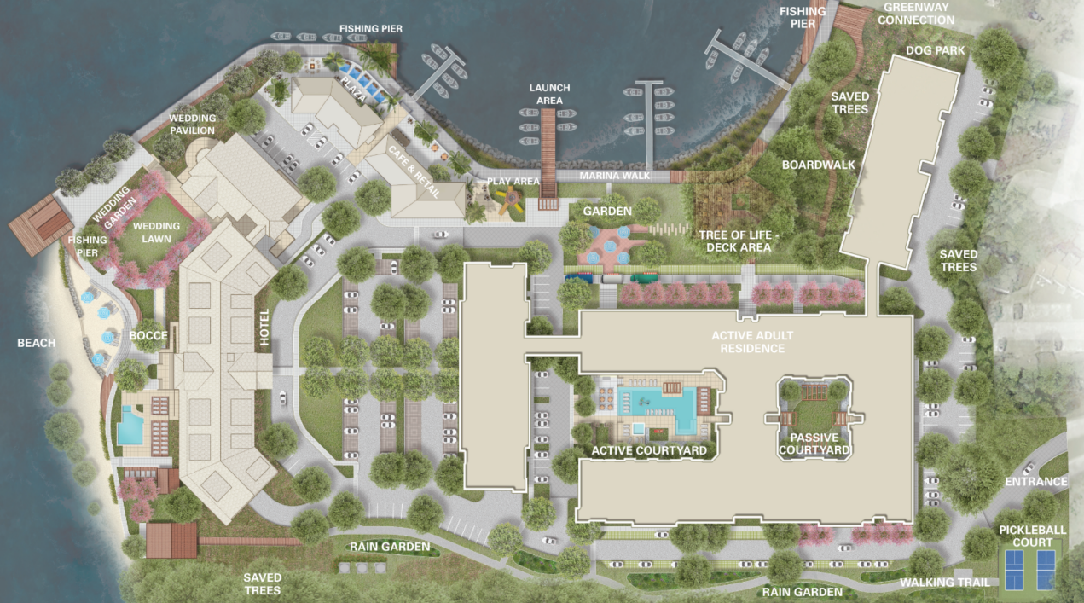

Slide 5
Program Overview
Site Size:
          Approximately 22.774 acres / 992,035 Square Feet
Program Overview
Active Adult – 201 units
Boutique Hotel – 82 rooms
Food & Beverage –
  Two-story restaurant
  Café/marina office
Marina – 103 slips

Slide 6
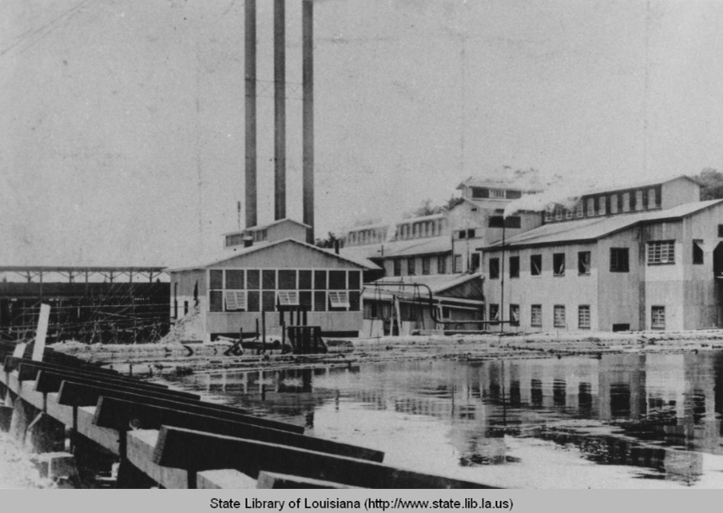

Slide 7
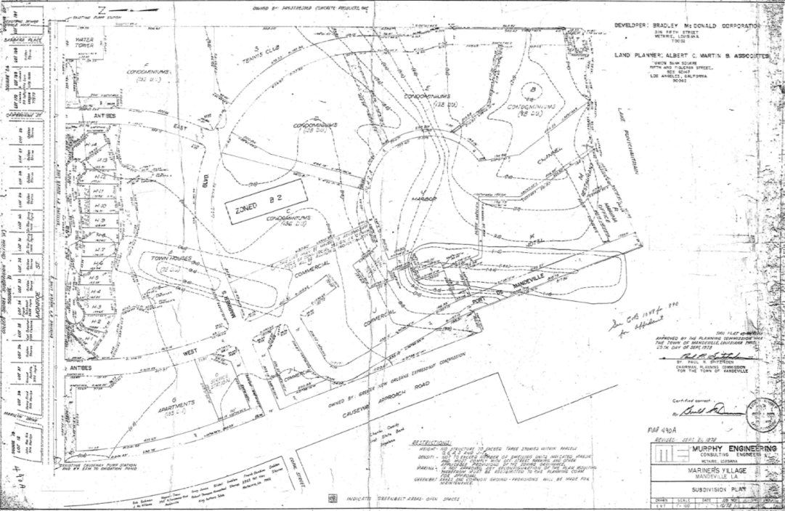

Slide 8
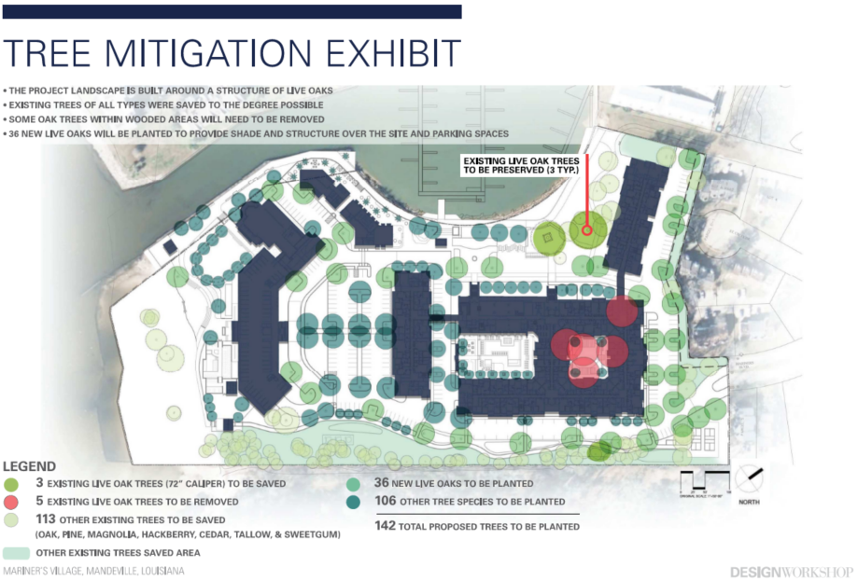

Slide 9
Live Oak Report
Retired LSU Landscape Architecture professor and Mandeville resident, Buck Abbey ASLA, prepared a report for the project. Below is a brief summary:
The report centers on five live oak trees which present a challenge for the development of the site.
These subject trees are elongated due to competition for space and sunlight.
They have smaller root systems and lack balance and are subject to wind damage.
These trees are forest trees rather than specimen open space trees.
They have been raked by hurricanes over the years adding to their disfigurement.

Slide 10
Live Oak Report
Irregularly shaped trees with a deficient leaf canopy and root zone are less likely to produce environmental benefits.
Abbey states that younger live oaks will provide greater benefits to the citizens of the community.
Substituting older, less productive trees with younger trees is a thoughtful and logical tradeoff to achieve better environmental productivity.

Slide 11
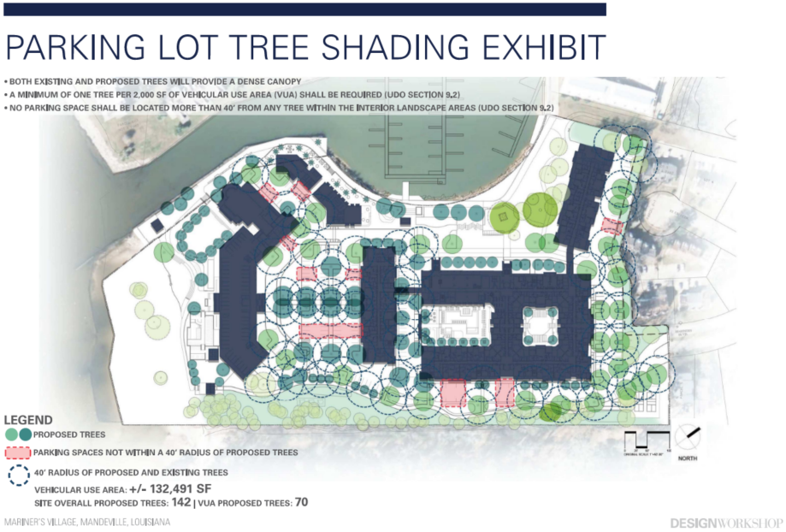

Slide 13
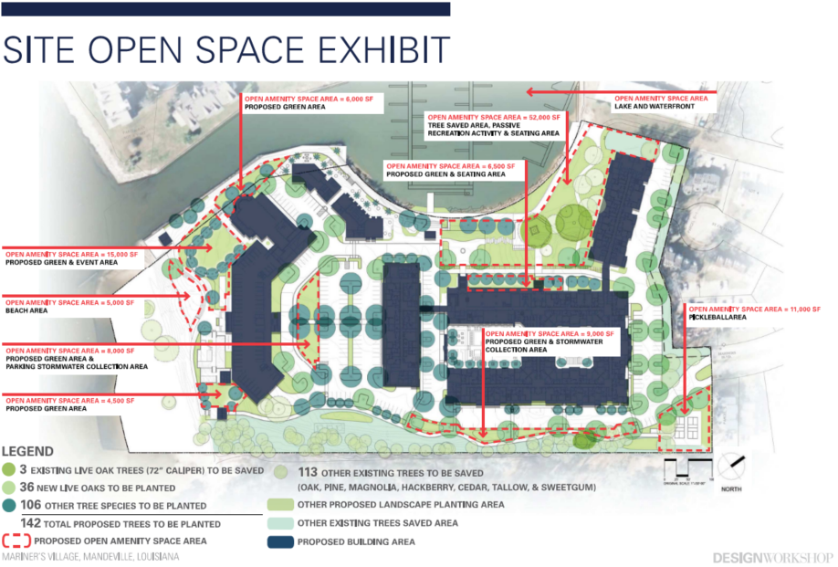

Slide 14
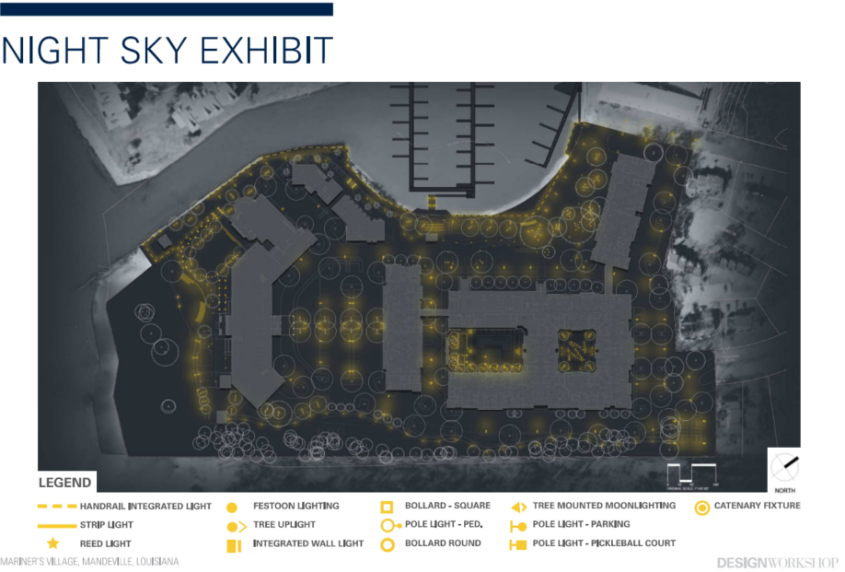

Slide 16
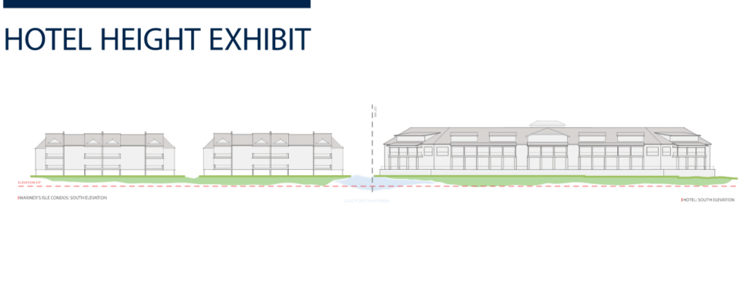
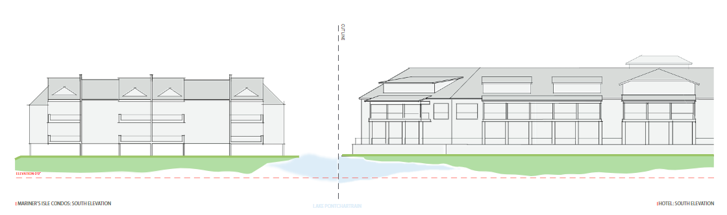

Slide 17
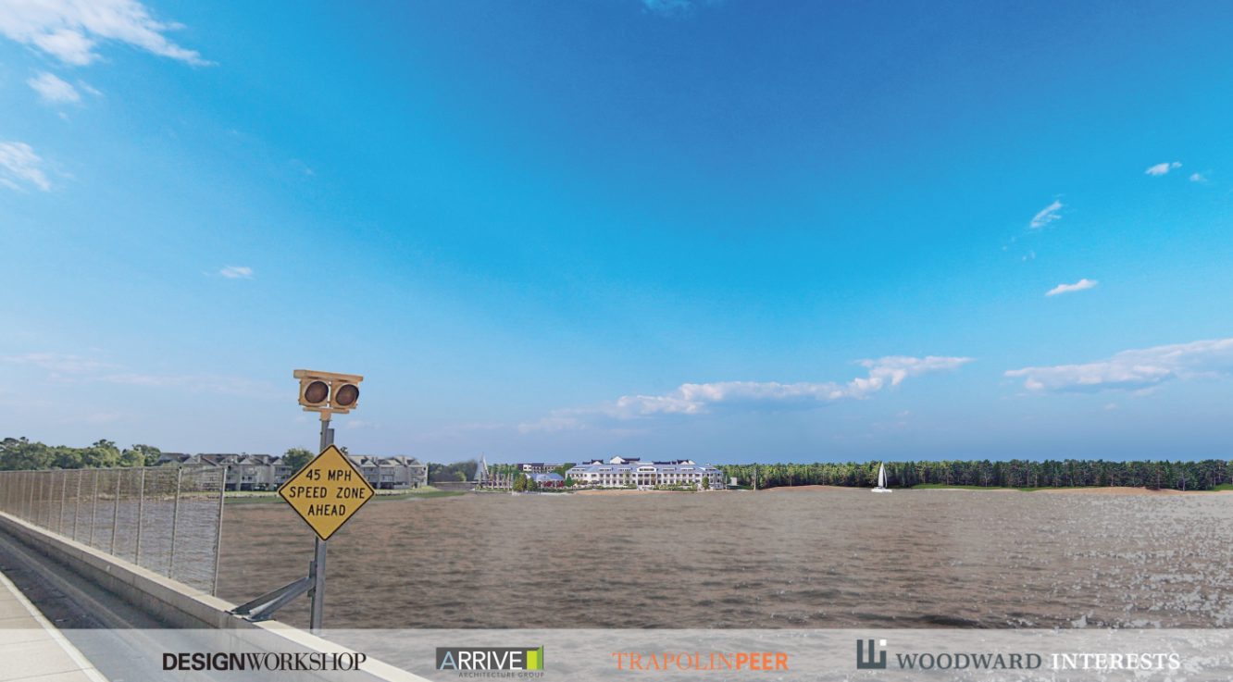

Slide 18
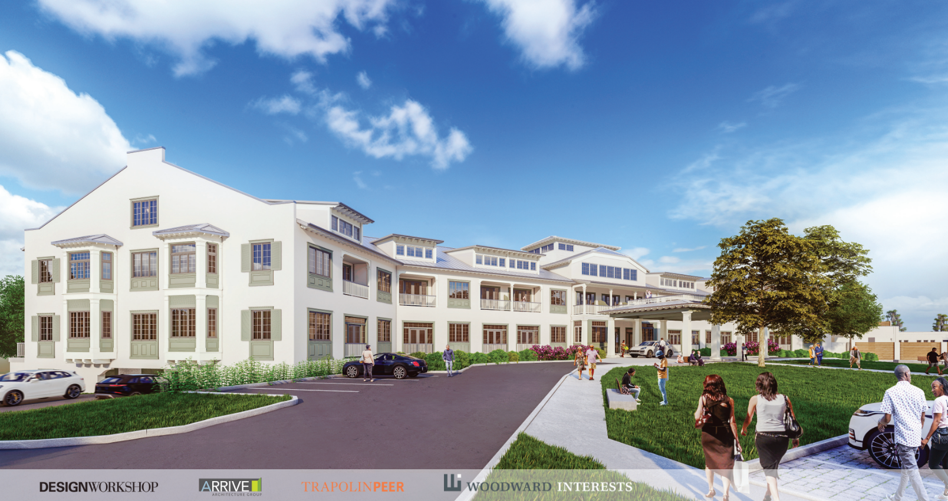

Slide 19
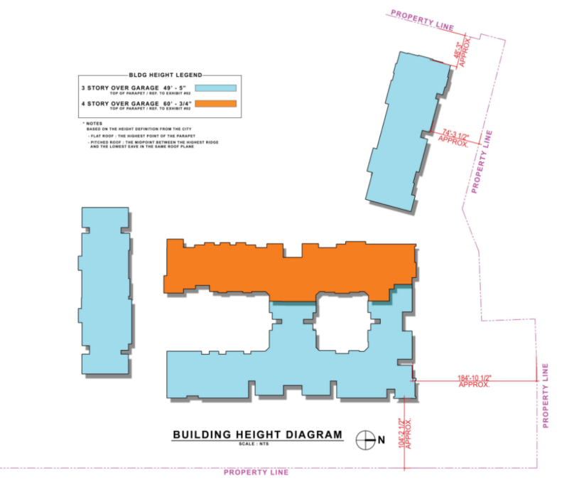

Slide 20
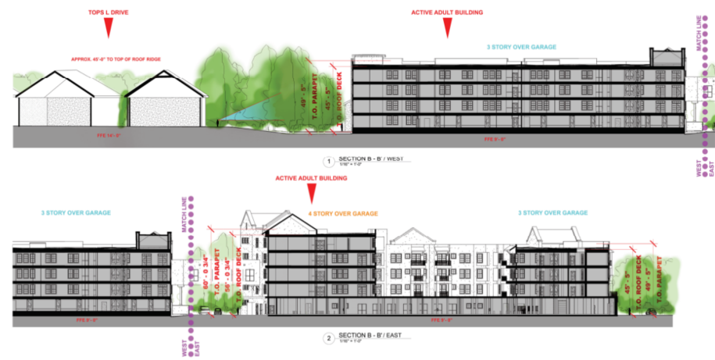

Slide 21
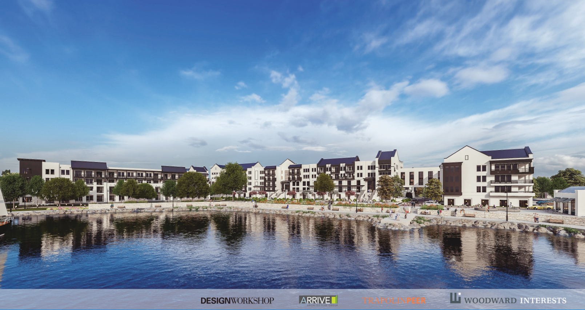

Slide 22
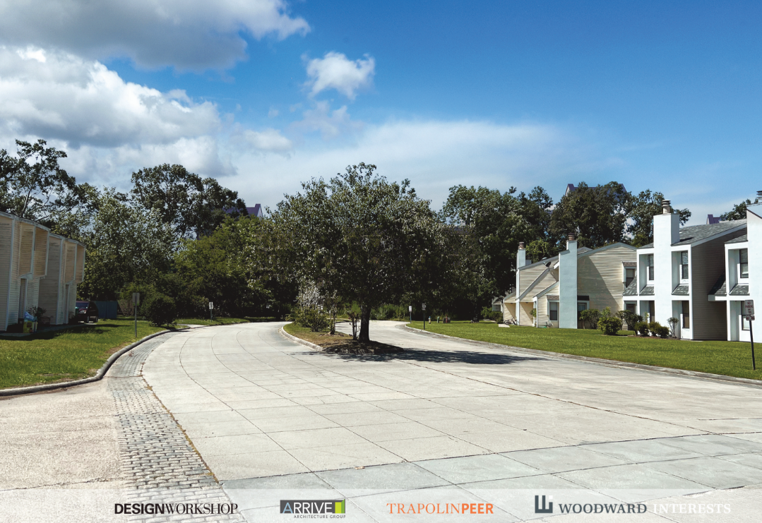

Slide 23
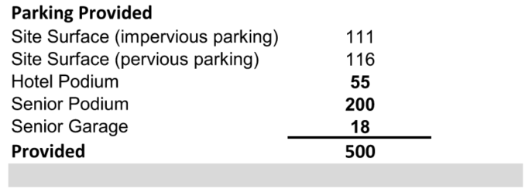
Parking
Presented to P&Z on 9/21

Slide 24
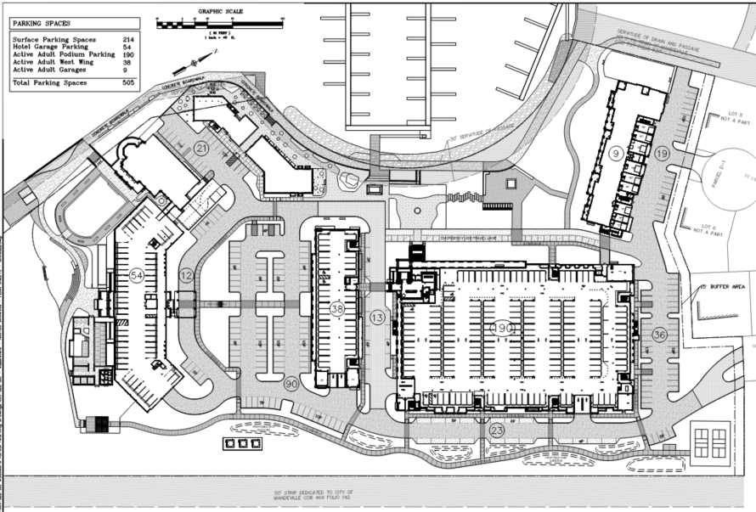

Slide 25
Parking – Sundays through Thursdays
The below table shows the hourly parking need for Sundays through Thursdays. Assumptions include:
Fully occupied active adult
Fully occupied hotel plus occupied meeting space
Full restaurant and café during operating hours
Fully used marina

Slide 26
Parking – Fridays & Saturdays
The below table shows the hourly parking need for Fridays and Saturdays. Assumptions include:
Fully occupied active adult
Fully occupied hotel plus occupied meeting and event space
Full restaurant and café during operating hours
Fully used marina
Peak hours are expected to be between 10:00 am – 2:00 pm when there is an overlap of diners and events on site. This is does not assume any cross-user parking.

